Slide 1

Social determinants of health in the EHR
HSCRN
October 2024
Annemarie G. Hirsch, PhD, MPH
Geisinger and Johns Hopkins Bloomberg School of Public Health
Center for Community Environment and Health
Department of Population Health Sciences
Geisinger
1

Slide 2
Overview
Electronic health record systems
Medical coding
SDoH screening
Natural language processing
Surrogate measures for SDoH
Social-spatial determinants of health
Conclusions and recommendations

Slide 3
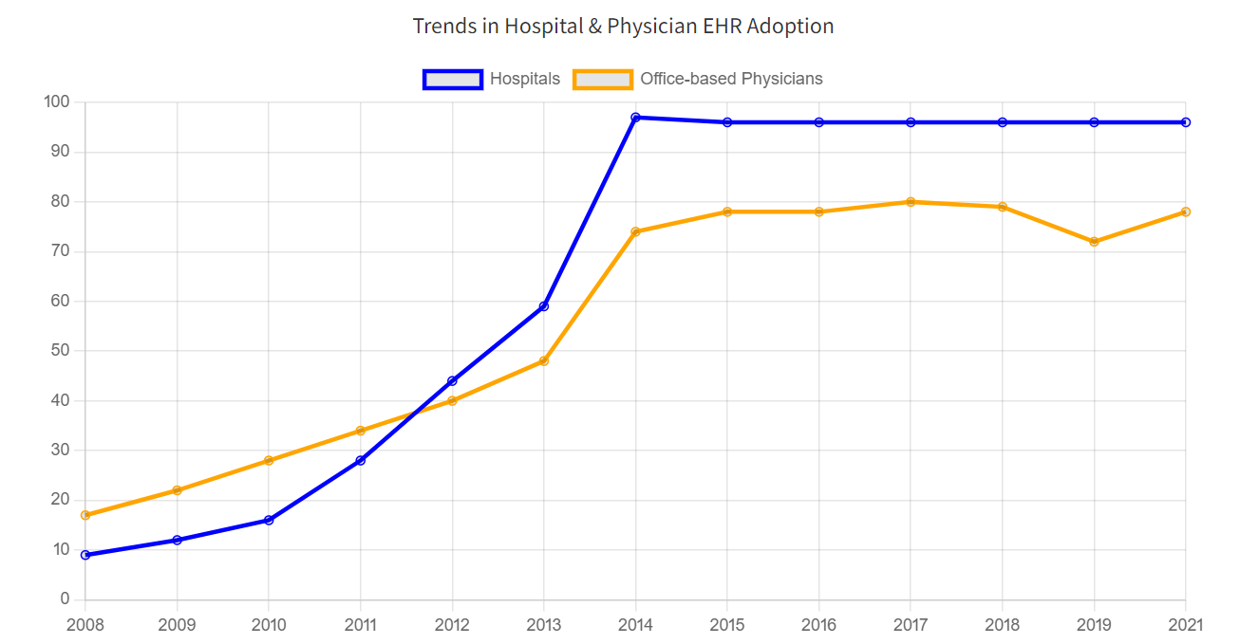
https://www.healthit.gov/data/quickstats/national-trends-hospital-and-physician-adoption-electronic-health-records

Slide 4
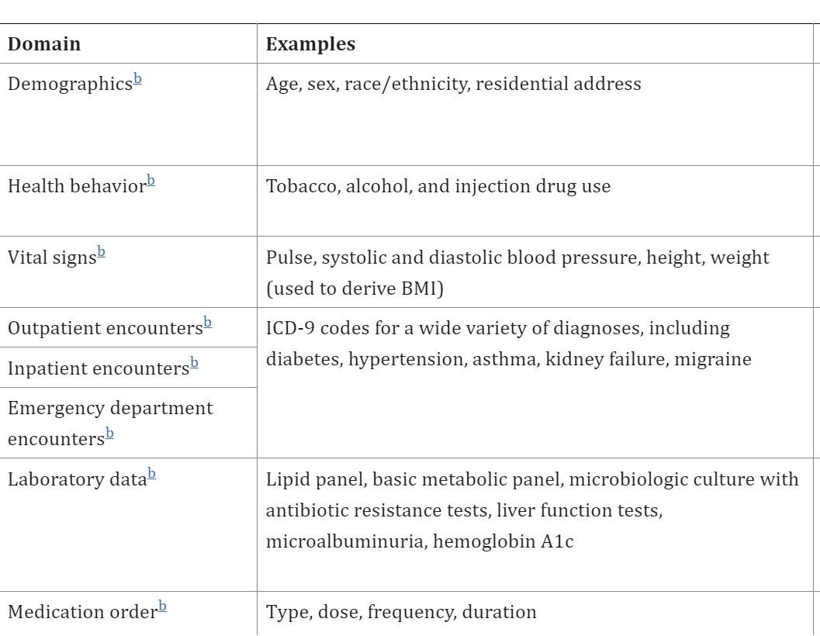
EHR Systems: What is in there?
Casey JA, et al. Using electronic health records for population health research: A review of methods and applications. Annu Rev Public Health. 2016; 37: 61 – 81.

Slide 5

What about SDoH data?
National Academy of Medicine recommended the following SDoH information be recorded in the EHR.
  Race/ethnicity
  Tobacco use
  Alcohol use
  Residential address
  Depression
  Education
  Financial resource strain
  Stress
  Physical activity
  Social isolation
  Intimate partner violence
  Neighborhood median household income
NAM (National Academy of Medicine. 2014. Capturing social and behavioral domains and measures in electronic health records: Phase 2. Washington, DC: The National Academies Press.

Slide 6
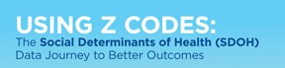



Social determinants of health in EHR systems
Where are we now?
2015
2014
2019
2023

Slide 7
Screening instruments
Clinician free text notes
Medical codes
Electronic health record

Slide 8

Medical Codes

Slide 9
Existing medical codes
Medical vocabularies (e.g., ICD-10-CM Z codes) include at least 1095 codes related to social determinants of health.¹
Z-codes were introduced in 2015 with the ICD-10 codes.
¹Arons A, et al. Documenting social determinants of health-related clinical activities using standardized medical vocabularies. JAMIA Open. 2019;2(1):81-88.
²Truong HT, et al. Utilization of social determinants of health ICD-10 Z-codes among hospitalized patients in the United States, 2016 – 2017. Medical Care. 2020;58:1037-1043.

Slide 10
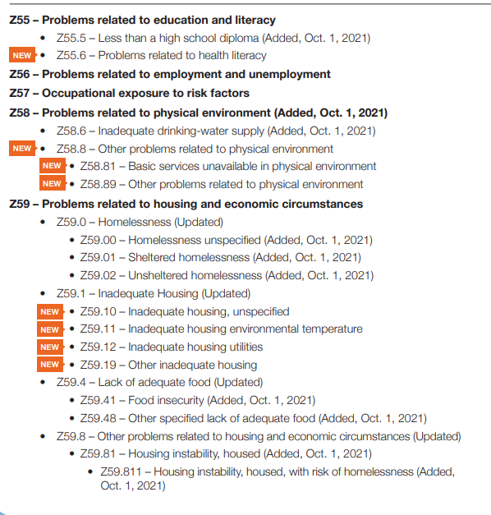

Slide 11
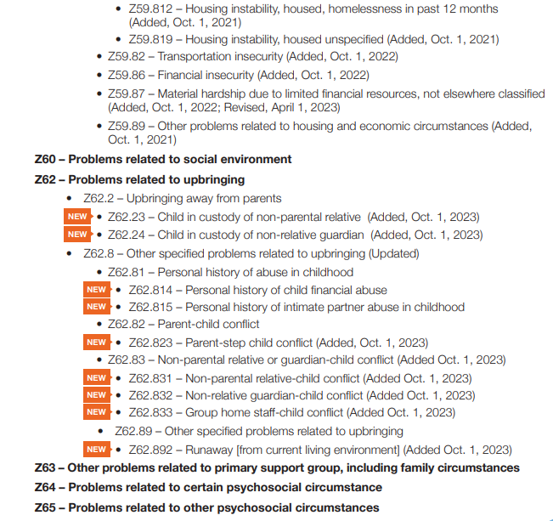

Slide 12
Existing medical codes
Challenges
  Limited reimbursement
  Codes are underutilized
    Only 1.6% of Medicare beneficiaries had any Z-code in their records (2019).
  Codes are not comprehensive.
Facilitators
  Z codes documented by any clinician can be used
  Self-reported data can be coded
  There is an effort to develop new ICD-10 Z codes.

Slide 13



SDoH Screening

Slide 14
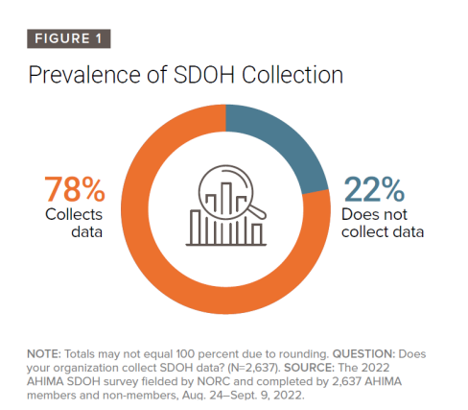
SDoH Screening
NORC at University of Chicago and American Health Information Management Association (AHIMA)

Slide 15
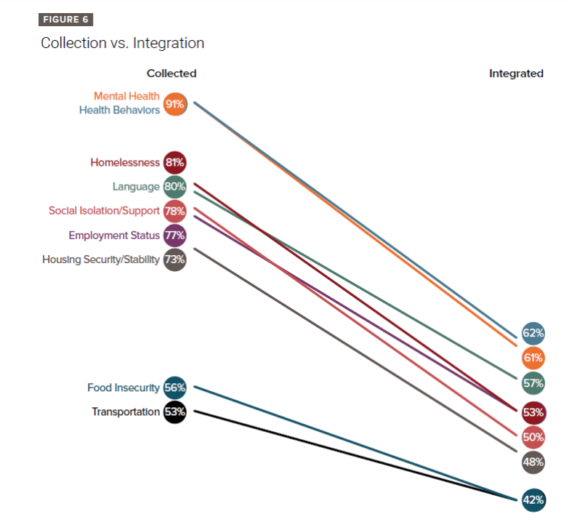
NORC at University of Chicago and American Health Information Management Association (AHIMA)

Slide 16
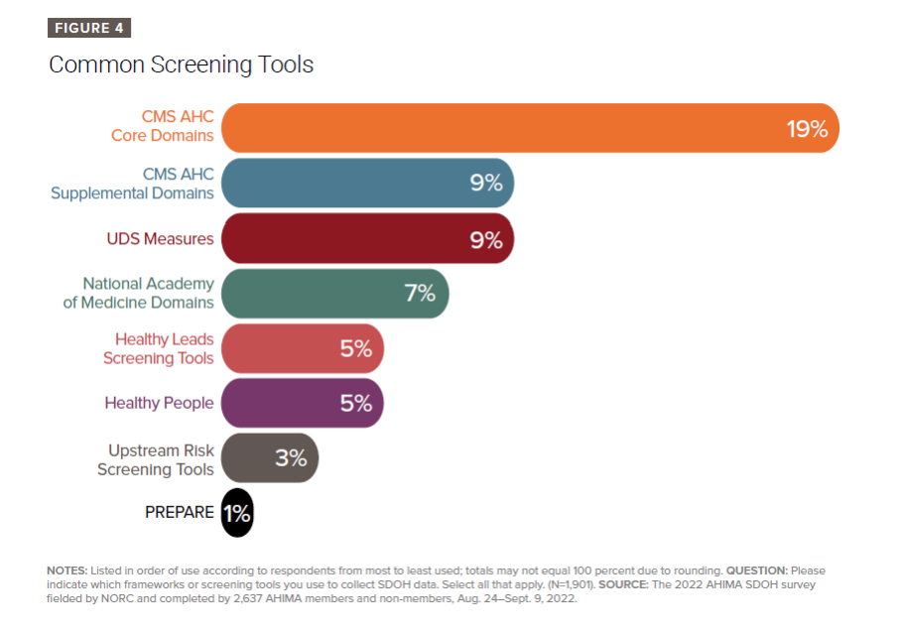
SDoH Screening
Health systems often customize screening tools
EHR vendors allow for built-in flexibility of screening tools.
NORC at University of Chicago and American Health Information Management Association (AHIMA)

Slide 17
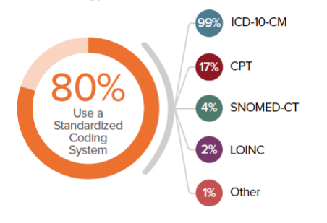
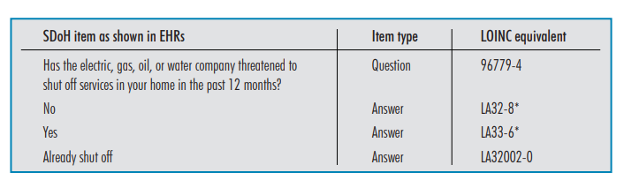
SDoH Screening
NORC at University of Chicago and American Health Information Management Association (AHIMA)
He Z, et al. Enriching real-world data with social determinants of health for health outcomes and health equity: Successes, challenges, and opportunities. Yearb Med Inform 2023. DOI: 10.1055/s-0043-1768732

Slide 18
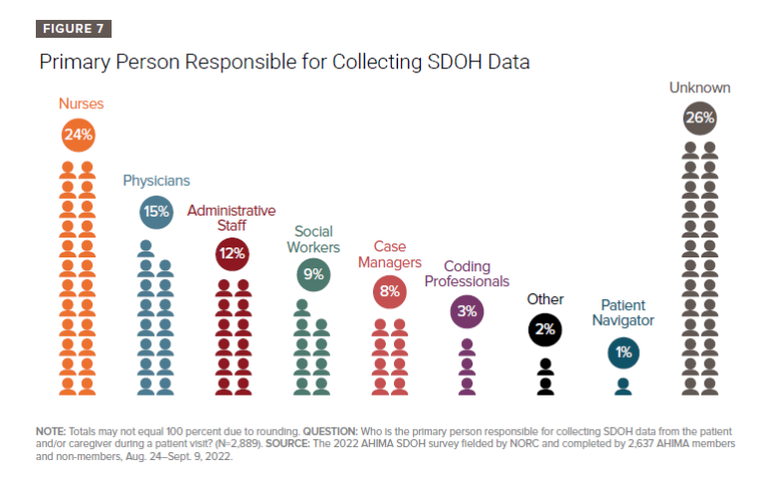
SDoH Screening
NORC at University of Chicago and American Health Information Management Association (AHIMA)

Slide 19

CMS Screening
Food insecurity
Interpersonal Safety
Housing Insecurity
Transportation insecurity
Utilities
Number of adult patients screened
Number of adult patients who screened positive in any domain
CMS SDoH inpatient reporting
Dates
  Voluntary in 2023
  Required in 2024
  2 inpatient quality metrics in 2024
Data collection tools: unspecified
Coding standards: unspecified

Slide 20
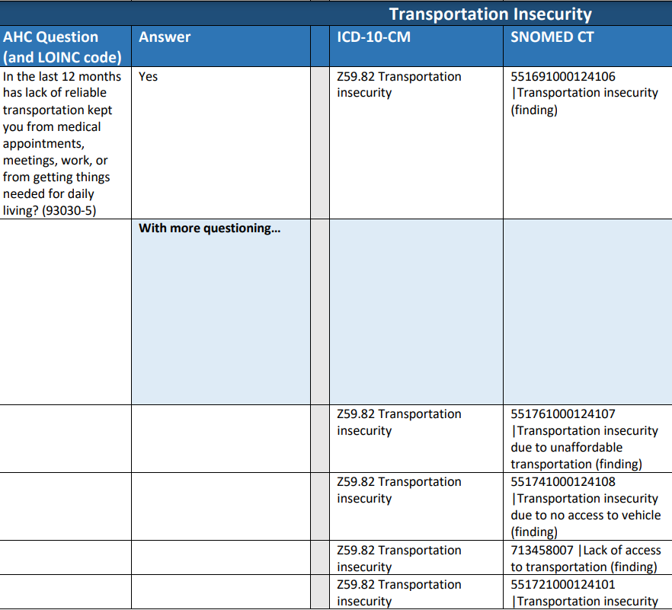
Gravity_AHC_HRSN_Documentation_Resource_V1.1.

Slide 21
Unstructured EHR Data

Slide 22
“In an ideal world all of this [SDH] information would be collected in a codified way…, but we have not begun to even look at the free text physician notes section, where they anticipate even more information may be collected.” – EHR vendor
About 80% of medical data in the EHR are unstructured:
encounter notes
discharge summaries
radiology/pathology reports
HHS. Incorporating social determinants of health in electronic health record: a qualitative study of perspective on current practices among top vendors. Final report. November 2018.

Slide 23
Free-text notes
“Due to transportation difficulties and lack of insurance, she only attended two prenatal appointments.”
“…she stopped getting them (mammograms) anymore because her insurance stopped paying.”
“Does not feel it (antidepressant) would help her as a lot of her mood changes are due to financial situation.”
“C/o ongoing depression… Worsening over the past year. Also grew up in foster care and suffered physical and emotional abuse.”

Slide 24
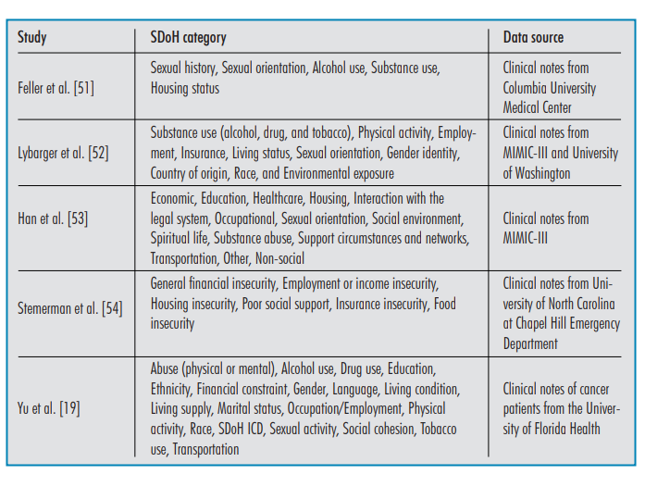
He Z, et al. Enriching real-world data with social determinants of health for health outcomes and health equity: Successes, challenges, and opportunities. Yearb Med Inform 2023. DOI: 10.1055/s-0043-1768732

Slide 25
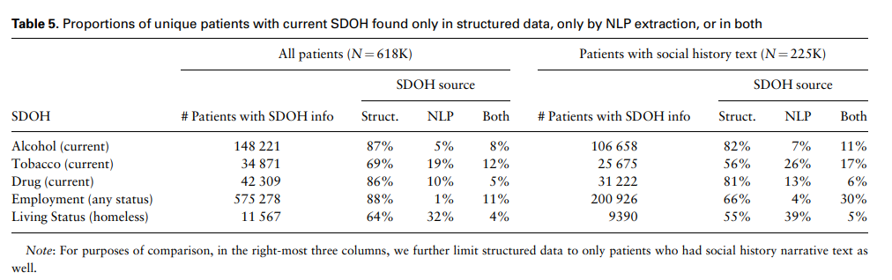
Free-text notes
Lybarger K, et al. Leveraging NLP to augment structured social determinants of health data in the electronic health record. JAMIA. 2023; 30(8): 1389 – 1397.

Slide 26
Free-text notes: Natural Language Processing
Challenges
  Currently no “off-the-shelf” comprehensive package for SDoH extraction
  Extensive fine-tuning required to adopt NLP pipeline at a new institution
  Accuracy depends on:
    quality and consistency of the data
    choice of NLP model
    development and training of NLP algorithm
  Documentation of certain SDoH categories is poor in clinical notes.

Slide 27
Surrogate Measures

Slide 28
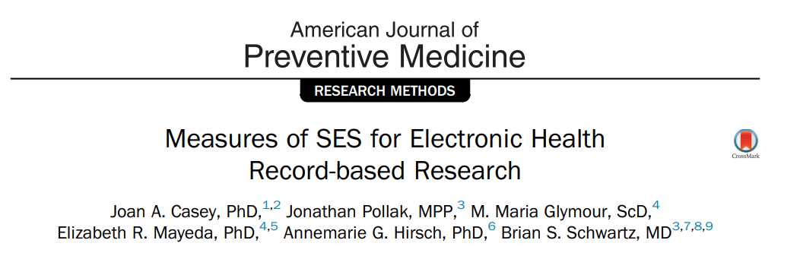
Medicaid Status
Advantages
  Eligibility based on poverty status
  Discrete data field
  Complete data
  High quality data
  Minimal data collection burden
Disadvantages
  Eligibility depends on more than SES
  Income threshold can differ by age, pregnancy status, etc.
  Eligibility changes with time

Slide 29
Social-spatial
determinants of health

Slide 30
Social-spatial determinants of health
Home street address routinely recorded
Geocode and link to external community data
  US Census Bureau
  Commercial data sets
Some health systems piloting storing community-level measures in the EHR.
  Community vital signs
  Envirome Web Service
Kane, N. J., Gerkovich, M. M., Breitkreutz, M., Rivera, B., Kunchithapatham, H., & Hoffman, M. A. (2021). The Envirome web service: Patient context at the point of care. Journal of Bioinformatics. 119, 103817.
Bazemore, A. W., Cottrell, E. K., Gold, R., Hughes, L. S., Phillips, R. L., Angier, H., Burdick, T. E., Carrozza, M. A., & DeVoe, J. E. (2016). “Community vital signs”: incorporating geocoded social determinants into electronic records to promote patient and population health. J Am Medical Informatics Association. 23, 407-412.

Slide 31
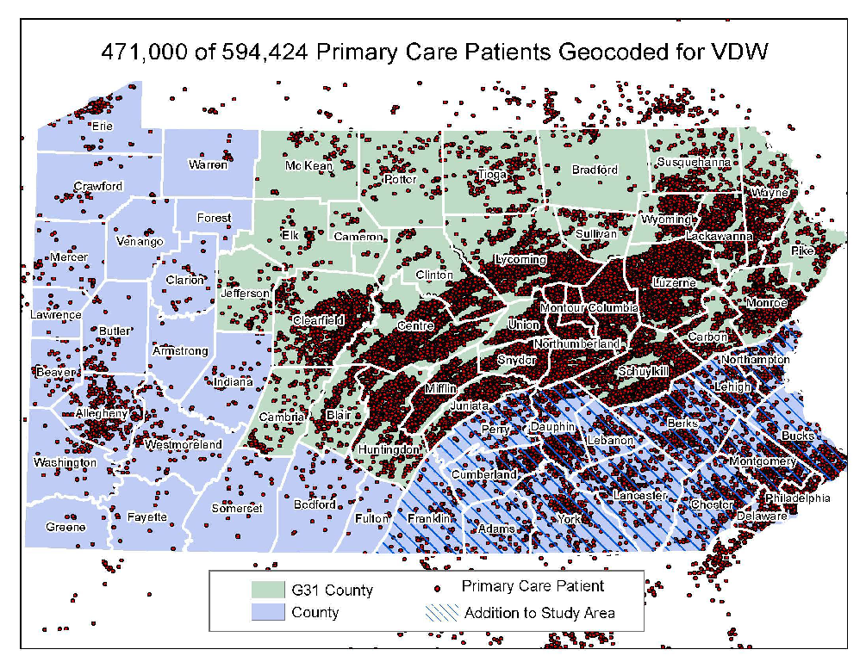
Spatial distribution of Geisinger primary care patients

Slide 32
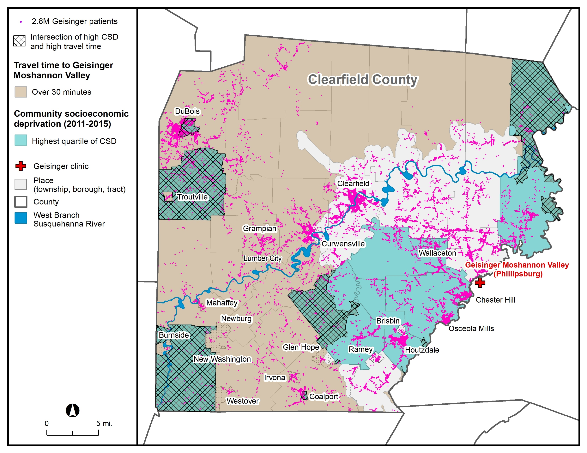

Slide 33
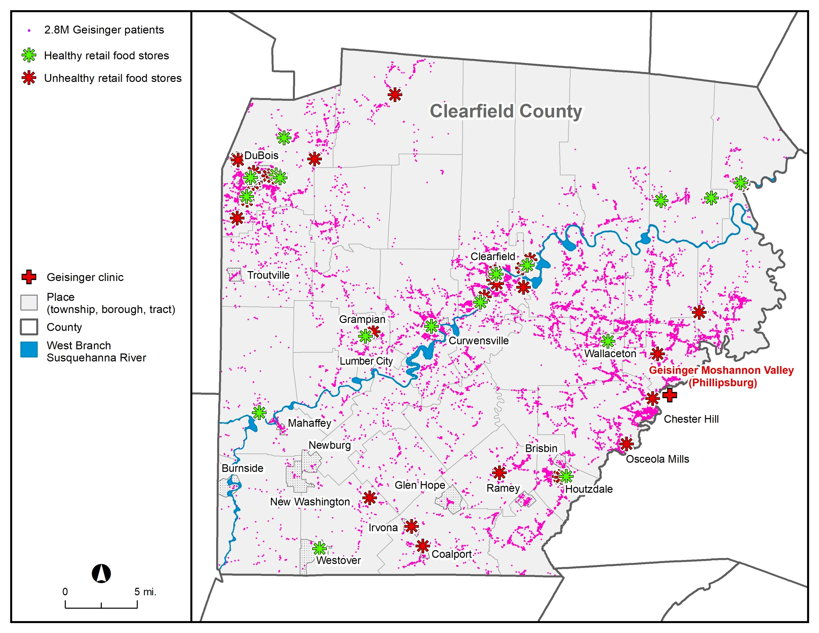

Slide 35
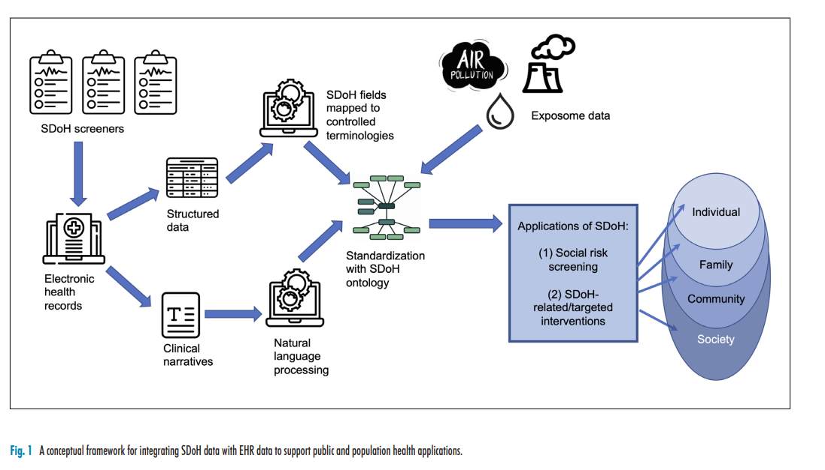
He Z, et al. Enriching real-world data with social determinants of health for health outcomes and health equity: Successes, challenges, and opportunities. Yearb Med Inform 2023. DOI: 10.1055/s-0043-1768732

Slide 36
General Challenges
Data entered in the EHR is for clinical care and billing purposes.
Potential issues:
  Completeness
  Data quality
  Temporality
  Lack of standardization

Slide 37
General Recommendations
Work with clinicians, quality leaders, and IT to understand:
  What data is being collected?
  How is it being collected?
  How often is it being collected?
  When did data collection start?
  What triggers data collection?
  Have there been changes in data collection over time?
  Are there plans to change data collection?
  What clinics/populations are being targeted?
  What policies/incentives are driving data collection?

Slide 38
Questions?

