Slide 1
1
Rapid Case Ascertainment of
Venous Thromboembolism Events
in a Population-based Setting
for Epidemiologic Research
Laura B. Harrington, PhD, MPH
June 11, 2024
Assistant Investigator, KPWHRI
Affiliate Assistant Professor, UW Dept. of Epidemiology
Assistant Professor, KPSOM
laura.b.harrington@kp.org

Slide 2
Cardiovascular Epidemiologist
2
Who uses epidemiologic study designs:
  Cohort
  Case-control
  Cross-sectional
And a variety of data sources:
  Women’s Health Initiative
  Heart and Vascular Health Study
  Adult Changes in Thought Study
  Nurses’ Health Studies I & II
  Cardiovascular Health Study
  New population-based studies in Kaiser Permanente!
Cardiovascular Health
Aging
Women’s Health
Notes:
To give a bit of background about me and what I do, I am a cardiovascular epidemiologist with primary research interests that lie at the intersection of cardiovascular health, aging, and women’s health.
My work tends to use case-control, cohort, and cross-sectional study designs.
And I’ve been lucky enough to work with several longstanding studies, including the KP Washington-based Heart and Vascular Health Study, the Women’s Health Initiative, the Nurses’ Health Studies I and II, the Health Professionals Follow-up Study, and the Cardiovascular Health Study.

Slide 3
Outline
3
Epidemiology of Venous Thromboembolism (VTE)
Rapid Case Ascertainment of VTE Events
Research about Venous Events (RaVE) study
After Venous Thromboembolism Research (AFTER) study

Slide 4
Outline
4
Epidemiology of Venous Thromboembolism (VTE)
Rapid Case Ascertainment of VTE Events
Research about Venous Events (RaVE) study
After Venous Thromboembolism Research (AFTER) study

Slide 5
Venous Thromboembolism (VTE)
5
Venous thromboembolism (VTE) is a clotting event in the veins occurring as:
  clot in the legs or pelvis=deep vein thrombosis (DVT).
  embolized clot that traveled to the lungs=pulmonary embolism (PE).

Slide 6
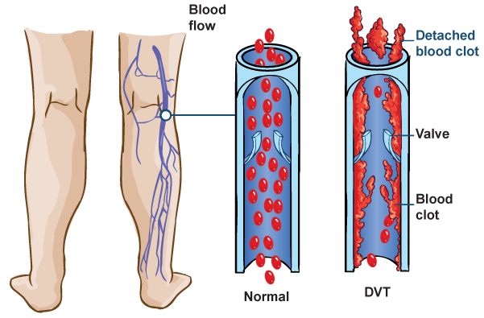
Deep Vein Thrombosis (DVT)
6
http://www.nlm.nih.gov/medlineplus/magazine/issues/spring11/articles/spring11pg18.html

Slide 7
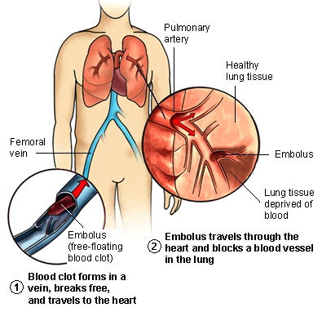
Pulmonary Embolism (PE)
7
http://www.medicalook.com/Lung_diseases/Pulmonary_embolism.html

Slide 8
VTE Etiology
8
Hemostasis involves balance of coagulation and fibrinolysis
Venous Stasis (Immobility, Polycythemia)
Virchow’s Triad
Blood Coagulability (Hereditary: Factor V Leiden, Protein C and S deficiency, Prothrombin;
Acquired: Cancer, Chemo, Exogenous Hormones, Pregnancy, Obesity)
Endothelial Damage (Endothelial damage: surgery, catheter, trauma; Endothelial dysfunction: smoking, hypertension)
Figure adapted from: “McMaster Pathophysiology Review: Venous Thromboembolism.” http://www.pathophys.org/vte/

Slide 9
Epidemiology of VTE
9
VTE is the third most common vascular diagnosis:
  1-2 events per 1,000 person-years overall
  8-10 per 1,000 person-years in persons 80+
~1 in 12 individuals diagnosed with VTE in their lifetime
Associated with mortality:
  10-30% of persons with VTE die within 30 days
  Among PE events, >20% die on day of PE
Associated with morbidity:
  30% of VTE cases recur within 10 years
Understanding of risk factors, etiology, and sequelae incomplete
Beckman MG. Am J Prev Med. 2010; Heit JA. J Thromb Thrombolysis. 2016; Fitzgerald KC. Women & Health. 2013.
Notes:
So why is it important to research VTE?
Cardiovascular disease is the leading cause of death in the world.
Within this, VTE is the third most common vascular diagnosis, second to stroke and myocardial infarction,
Occurring at a rate of about 1-2 per 1,000 person-years overall
and at a much higher rate of about 8-10 per 1,000 person-years in persons 80+.
It is associated with substantial mortality:
--10-30% of persons with VTE will die within 30 days, with most of these people suffering from a PE.
--Among people suffering from a PE, more than 20% die on the day of the PE, and 35% die within 30 days.
And with morbidity:
--For example, approximately 30% of VTE cases will experience recurrence within 10 years.
This being said, our understanding of VTE etiology and risk factors is incomplete and there is more understanding needed to understand, prevent, and treat this disease.

Slide 10
Outline
10
Epidemiology of Venous Thromboembolism (VTE)
Rapid Case Ascertainment of VTE Events
Research about Venous Events (RaVE) study
After Venous Thromboembolism Research (AFTER) study

Slide 11
Rapid Case Ascertainment of VTE
11
Quick identification and validation of incident VTE events in near “real-time”
Usually 1-2 days
Programmer identifies possible event
Outreach to enroll in cohort or conduct retrospective interview
Incident VTE Diagnosis
Time
Event validation via medical record abstraction
Usually Same-Day
Invalid
Valid

Slide 12
Fast participant outreach supports…
12
Interviews about retrospective behaviors
Enrollment in a prospective cohort, including possible:
  Reported behaviors, symptoms, sequelae soon after an event
  Blood collection soon after an event

Slide 13
Outline
13
Epidemiology of Venous Thromboembolism (VTE)
Rapid Case Ascertainment of VTE Events
Research about Venous Events (RaVE) study
After Venous Thromboembolism Research (AFTER) study

Slide 14
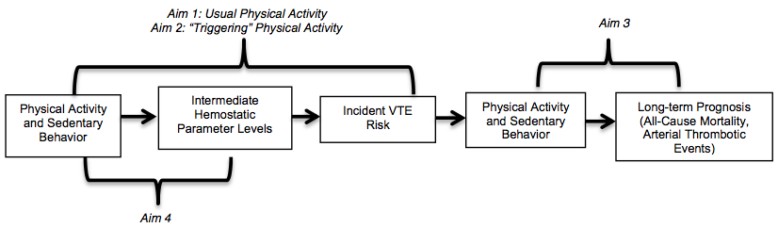
Research about Venous Events (RaVE):
Aim 2 of K01HL139997
14
Goal: Further our understanding of physical activity and sedentary behavior in relation to:
  1) incident VTE risk
  2) short-term VTE risk following physical activity
  3) long-term prognosis following an incident VTE
  4) hemostatic factor levels
Notes:
While gaining training in:
Lifestyle epi
Aging epi
Primary data collection
Advanced epi study design/analysis

Slide 15
Physical Activity (PA) as a Trigger
15
Usual physical activity (PA) may be differently associated with VTE risk than acute moderate/vigorous PA
Biologically plausible that VTE risk is greater in time period following PA
  Based on studies suggesting transient hypercoagulable state following PA
Vigorous PA has been acutely associated with greater risk of arterial thrombotic events such as MI and sudden cardiac death → using case-crossover design

Slide 16
Objective, Setting, and Study Design
16
Objective: Evaluate short-term risk of VTE symptom onset following PA in a case-crossover study
  Hypothesis: Moderate to vigorous PA will be associated with a greater risk of VTE symptom onset in the 4 days following PA
Setting: Population-based Research about Venous Events (RaVE) study
  Adults with validated incident VTE in Kaiser Permanente Washington, identified across ~2 years
    October 2019 to December 2021
Study Design: Case-crossover study
  Contribute time as a case in the 4 days prior to VTE
  Contribute time as a control in the 6 months prior to VTE

Slide 17
Real-World Study Process
17
Every weekday (other than some Fridays):
  Programmer identified possible VTE events among eligible adults using ICD-10 codes
  Programmer notified abstractors that possible cases ready to review
  Abstractors reviewed & validated possible cases using the EHR
  Abstractors & programmer sent valid cases to KPWHRI’s Survey Research Program (SRP)
Next day, SRP sent letter explaining study to valid cases
  Maildate + 2 days = call window starts
ICD-10 date + 14 days = call window ends
Telephone Survey completed by SRP (20-45 minutes)

Slide 18
Telephone Survey
18
Index VTE
VTE-relevant symptoms and symptom onset date
Behaviors (e.g. walking, leisure-time physical activity, sedentary behavior, long-haul travel, traffic exposure)
  In each of the 4 days prior to VTE symptom onset date
  Over the past 6 months

Slide 19
VTE Symptom Start Date
19
Participants asked by symptom (yes/no) if they experienced:
  Pain, tenderness, or a heavy aching in legs, arm, pelvis
  Swelling in leg, arm, pelvis
  Warm skin in leg, arm, pelvis
  Redness in leg, arm, pelvis
  Shortness of breath
  Chest pain or discomfort
  Lightheadedness, feeling dizzy, fainting
  Rapid pulse
  Coughing up blood
Earliest date that any of those symptoms began
  →equals “VTE Symptom Start Date”

Slide 20
Physical Activity Exposure Ascertainment
20
On [SYMPTOM START DATE], did you do physical activities for exercise and sport besides walking, and if so, what activities did you do?
  Activity X
  Activity Y
  Activity Z…
For how many minutes did you do [Activity X]
Using the “talk test”, would you describe your [Activity X] to be of vigorous, moderate, or mild intensity?
  Vigorous=cannot say more than a few words without pausing for a breath;
  Moderate=can talk but not sing during the activity;
  Mild=aren’t out of breath.
Repeated, asking about “typical week” over the past 6 months

Slide 21
Valid VTE Events
21
Event valid and sent for telephone survey if:
  Clear clinical confirmatory note OR confirmatory imaging
  No evidence of past VTE
  No evidence during of non-English-speaking/non-verbal
  No evidence during chart review of dementia

Slide 22
Adults with VTE Identified, Validated, and Surveyed (10/16/19-12/15/21)
22
1,176
Eligible Adults with Possible Incident VTEs Identified by ICD-10 Codes & Eligible for Chart Review
840
Adults with Valid Incident VTEs eligible for telephone survey
(71% of reviewed VTEs valid)
315 completed full survey (38% response rate)
302 eligible for analysis

Slide 23
Timing of Abstraction and Survey
23

Slide 24
Timing of Abstraction and Survey
24

Slide 25
Timing of Abstraction and Survey
25

Slide 26
Population Characteristics
26

Slide 27
Rate Ratio for VTE Symptom Onset within 1 Day of Any MVPA
27

Slide 28
Rate Ratio for VTE Symptom Onset within 1 Day of Any MVPA
28

Slide 29
Rate Ratio for VTE Symptom Onset within 1 Day of Any MVPA
29

Slide 30
Conclusions
30
No evidence that risk of VTE symptom onset was higher within a day with any MVPA
In stratified analyses, rate ratios did not appear to differ meaningfully by:
  sex, age category, frequency of MVPA in past 6 months, obesity status, provoked vs. unprovoked incident VTE, incident VTE type
Although vigorous PA has been acutely associated with a greater risk of arterial thrombotic events such as MI and sudden cardiac death, MVPA does not appear to have this association with VTE symptom onset

Slide 31
Rapid Case Ascertainment in RaVE
Participant recall of behaviors on specific days pre-incident VTE and in 6 months prior requires contact shortly after the event to reduce recall bias

Slide 32
Outline
32
Epidemiology of Venous Thromboembolism (VTE)
Rapid Case Ascertainment of VTE Events
Research about Venous Events (RaVE) study
After Venous Thromboembolism Research (AFTER) study

Slide 33
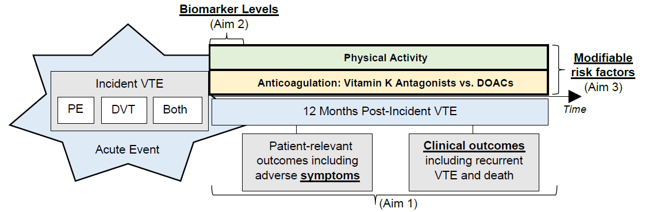
After Venous Thromboembolism Research (AFTER) Study: R01HL166292
33
Goal: Characterize patient-relevant symptoms and clinical outcomes at multiple timepoints in the first 12 months post-VTE and evaluate biomarkers and modifiable risk factors in relation to these adverse VTE sequelae

Slide 34
Non-acute outcomes of VTE are Poorly Understood
Symptoms post-VTE seem to be common, but incompletely understood and underdiagnosed
Post-DVT:
  Post-thrombotic syndrome experienced by 20 to 50%of adults
Post-PE:
  Chronic thromboembolic pulmonary hypertension experienced among 4% of PE survivors
  “Post-PE syndrome” more recently being described, to include dyspnea, exercise intolerance, and poor quality of life

Slide 35
Need to understand markers of adverse VTE sequelae
Whether risk factors that can be modified post-VTE are associated with adverse clinical outcomes post-VTE is largely unknown
  Anticoagulation characteristics
  Physical activity
Most research about VTE sequelae conducted in era of treatment with vitamin K antagonists vs. direct oral anticoagulants (DOACs)
  ~80% treated with DOACs in KPWA
Need for identification of biomarkers measurable in routine clinical practice that are associated with adverse VTE sequelae

Slide 36
Specific Aims
36
Aim 1: Characterize prevalence pattern of symptoms at 2 weeks and 1, 3, 6, and 12 months post-incident VTE and clinical outcomes over the 12 months of follow-up, and evaluate whether there are changes in symptoms over time.
Aim 2: Evaluate associations of key biomarker levels (NTproBNP, D-dimer, troponin) measured in blood collected within 4 weeks of the incident VTE and symptoms and clinical outcomes over follow-up.
Aim 3: Evaluate 2 modifiable risk factors, anticoagulant type and physical activity level in relation to symptoms and clinical outcomes over follow-up.

Slide 37
Setting and Study Design
Setting: Population-based AFTER Study
  Adults with validated incident VTE in Kaiser Permanente Washington, anticipated to be identified across ~33 months
    Recruitment anticipated to start in July 2024
    ~957 eligible adults anticipated over 33 months
      ~380 (40%) anticipated to participate in study activities
Study Design: Inception cohort study

Slide 38
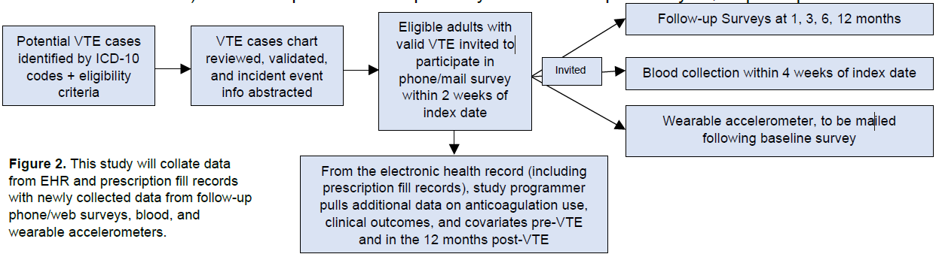
AFTER Study Activities

Slide 39
AFTER Study Activities

Slide 40
Rapid Case Ascertainment in the AFTER Study
Fast identification and enrollment is necessary to begin follow-up for VTE sequelae soon after the VTE and:
  To collect biomarker data
  To collect modifiable risk factor data shortly after the VTE

Slide 41
Thank You to RaVE and AFTER Teams!
41
RaVE Team and K01 Mentors
Susan Brandzel
Bianca DiJulio
Sascha Dublin
Tiffany Gaines
Kara Haugen
Majken Jensen
Ron Johnson
Luesa Jordan
Christopher Kabrhel
Jenna Leonardo
Lawrence Madziwa
Ken Mukamal
Matthew Nguyen
Paula Sandler
Gregory Wellenius
Nora Wheat
AFTER Team
Mary Cushman
Sascha Dublin
Hongyuan Gao
Mikael Anne Greenwood-Hickman
David Hsu
Laura Ichikawa
Tianna Kong
Jenna Leonardo
Maiya Love
Kelly Meyers
Ken Mukamal
Matthew Nguyen
Gaia Pocobelli
Dori Rosenberg
Paula Sandler
Nick Smith
Yu-Ru Su
Nora Wheat
Margie Wilcox

Slide 42
42
Thank you!
Questions?
laura.b.harrington@kp.org

Slide 43
43
EXTRA SLIDES

