Slide 1
Challenges in the Care for Opioid Use Disorder: A Multisite Study of Mortality among people who Discontinue Buprenorphine Treatment
Ingrid A. Binswanger, MD, MPH
Senior Clinician Investigator, Institute for Health Research, Kaiser Permanente Colorado
Chemical Dependency Treatment Services, Colorado Permanente Medical Group
Associate Professor and Director of Substance Use and Harm Reduction Research Development, University of Colorado School of Medicine
Adjunct Professor, Health Systems Science, Bernard J. Tyson Kaiser Permanente School of Medicine
Scientific Data Resources Forum, HCSRN
November 14, 2023

Slide 2

Acknowledgements and Disclosures
Funding: National Institute on Drug Abuse (NIDA) National Drug Abuse Treatment Clinical Trials Network (CTN) (UG1DA040314, CTN Protocol ID: CTN0084-A-1) Health Systems Node
The content is solely the responsibility of the authors and does not necessarily represent the official views of the National Institutes of Health, Kaiser Permanente, or Colorado Permanente Medical Group

Slide 3

Co-authors
Jason Glanz, PhD
Cynthia Campbell, PhD
Christina Clarke, MS
Morgan A. Ford, MA
Anh P. Nguyen, PhD
G. Thomas Ray, MBA
Stanley Xu, PhD
Rulin C. Hechter, MD, PhD
Bobbi Jo H. Yarborough, PsyD
Douglas W. Roblin, PhD
Brian Ahmedani, PhD
Joseph A. Boscarino, PhD
Susan E. Andrade, ScD
Carmen L. Rosa, MS
Glanz JM, Binswanger IA, Clarke CL, et al., The association between buprenorphine treatment duration and mortality: a multi-site cohort study of people who discontinued treatment. Addiction; 2023.118(2)97-107

Slide 4
Eight Participating Health Systems
Fallon Community Health Plan
Worcester, MA
Robin Clarke, PhD
Susan Andrade, ScD
Kaiser Permanente Colorado
Denver, CO
Ingrid Binswanger, MD & Jason Glanz, PhD
Henry Ford
Health System
Detroit, MI
Brian Ahmedani, PhD
Kaiser Permanente
Northwest
Portland, OR
Bobbi Jo Yarborough, PsyD
Kaiser Permanente
Northern California
Oakland, CA
Cynthia Campbell, PhD
Geisinger Health System
Danville, PA
Joseph Boscarino, PhD
Kaiser Permanente
Southern California
Pasadena, CA
Rulin Hechter, MD
Kaiser Permanente
Mid-Atlantic States
Rockville, MD
Douglas Roblin, PhD

Slide 5
Objectives
Understand national opioid overdose trends
Be aware of available opioid use disorder treatments and current challenges
An “optimal” buprenorphine treatment duration to reduce mortality? Understand the methods and results from a multi-site cohort study
Consider future directions and recommendations trying to address opioid use disorder and overdose

Slide 6
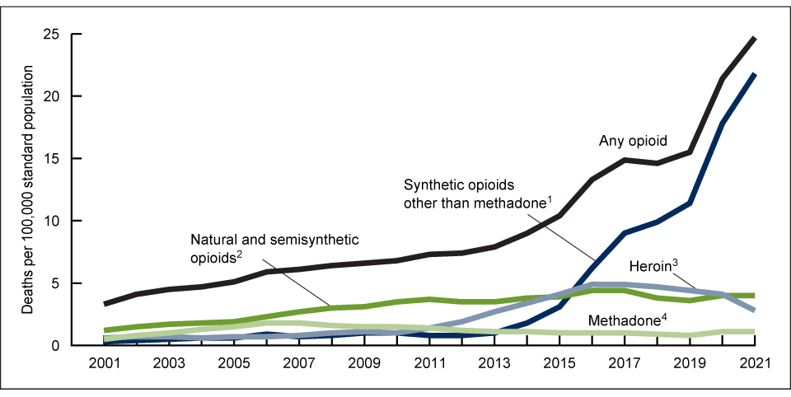

CDC: Age-adjusted rate of drug overdose deaths involving opioids, by type of opioid: United States, 2001–2021
Source: National Center for Health Statistics, National Vital Statistics System, Mortality File

Slide 7
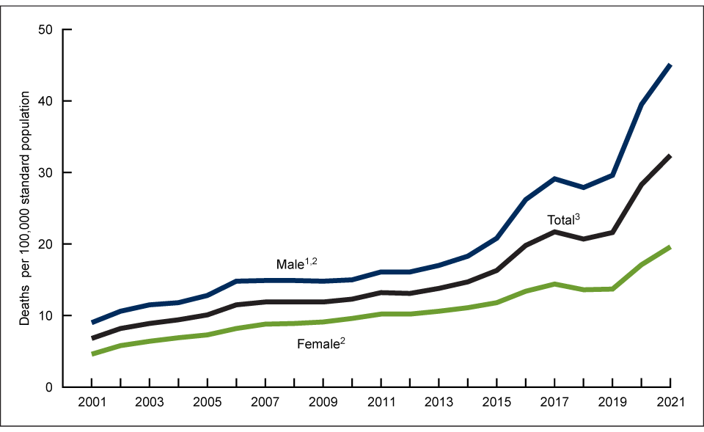
CDC: Age-adjusted rate of drug overdose deaths, by sex: United States, 2001–2021
Source: National Center for Health Statistics, National Vital Statistics System, Mortality File

Slide 8
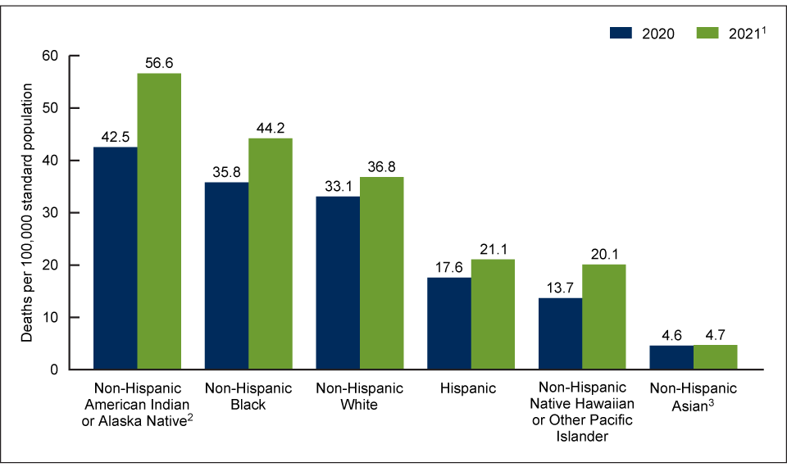
CDC: Age-adjusted rate of drug overdose deaths, by race and Hispanic origin: United States, 2020 and 2021
Source: National Center for Health Statistics, National Vital Statistics System, Mortality File

Slide 9
Opioid use disorder (OUD) criteria (DSM-5)
Taking more than or for longer than intended
Wanting to cut down or quit but can’t
Spending a lot of time on obtaining opioids
Craving
Role failures at work, school or home
Using despite interpersonal or social problems
Activities limited
Use despite knowing that there are physical or psychological consequences
Hazardous use
Tolerance
Withdrawal
Mild: 2-3 symptoms
Moderate: 4-5 symptoms
Severe: 6 or more symptoms
Notes:
9
Mild: 2-3 symptoms. Moderate: 4-5 symptoms. Severe: 6 or more symptoms

Slide 10
Estimated prevalence of opioid use disorder (OUD) in the United States
Prevalence increased in early 2000s
Estimated prevalence appears stable from 2016-2019
6.7-7.6 million adolescents and adults with OUD
2.04-2.77% of the population
Source: Keyes K, et al Drug and Alcohol Dependence, 2022
Notes:
10
Mild: 2-3 symptoms. Moderate: 4-5 symptoms. Severe: 6 or more symptoms

Slide 11



Three FDA approved options for OUD treatment
Buprenorphine/naloxone or buprenorphine: sublingual can be dispensed at regular pharmacy (Suboxone, Subutex) and intramuscular extended-release injection (Sublocade)
Methadone: oral, generally liquid form through licensed opioid treatment programs
Intramuscular extended-release (XR) naltrexone, generally office-based procedure (Vivitrol)

Slide 12
Buprenorphine extensively studied in randomized controlled trials
>30 studies of sublingual (SL) buprenorphine (or SL buprenorphine/naloxone)
Intervention durations of 2 weeks to 52 weeks
Compared SL buprenorphine to methadone, XR naltrexone or placebo
Methadone had higher retention rates than SL buprenorphine
Buprenorphine and XR naltrexone had similar retention rates
Buprenorphine had higher retention than placebo, with dose response
No difference in use of opioids (relapse) in all comparisons except buprenorphine high dose (>16 mg) to placebo
Lee, Nunes, Novo, et al. Lancet. 2018; Mattick, et al. Cochrane Database Syst Rev. 2014. Cornish, et al. BMJ. 2010, & others

Slide 13

Buprenorphine retention associated with lower mortality
Retention 40-50% and other opioid use or relapse 50-60%
Overdose and all-cause mortality lower during treatment than off treatment
Longer retention associated with lower relapse rates and improved survival
First 4 weeks off treatment riskier than remaining time (>4 weeks) off treatment
Cornish, et al. BMJ. 2010. Mattick, et al. Cochrane Database Syst Rev. 2014. Lee, Nunes, Novo, et al., Lancet. 2018. Sordo, et al. BMJ 2017. Larochelle MR, et all, Ann Intern Med. 2018; 169:137–45.

Slide 14
Population | Estimated retention rate | Positively associated with discontinuation | Positively associated with retention
VA | 38% discontinued within 1 year | Black race, higher comorbidity score, and emergency dept. visits
Medicaid | 28% discontinued before 30 days | Dose ≤ 4 mg, male, young, Black, Hispanic, capitated insurance, comorbid substance use disorders, comorbid chronic pain, hepatitis C, inpatient care, overdose | Antidepressant use
Privately insured | 55% discontinued within 1 year, and 86% within 3 years | Psychiatric hospitalization, emergency department visits, and other substance use disorders | Older age and outpatient psychotherapy
Commercially insured | 28% discontinued before 30 days | Lower initial dose (≤ 4 mg) and lower days supply (≤ 7 days vs. >28 days) (Lower days supply also assoc. with AEs)
Office-based opioid treatment collaborative | Emerging adults (18-25) 57% discontinuation at 3 months vs. 22% for older adults | Younger age
Manhapra A, Petrakis I, Rosenheck R. Am J Addict. 2017;26:572–80; Samples H, Williams AR, Olfson M et al., J Subst Abuse Treat. 2018; 95:9–17.

Slide 15

Current ASAM and SAMHSA Guidelines: No time limit on treatment for OUD
      If patients want to stop treatment:
      Make patients aware of the risks of opioid overdose and death if they use other opioids
      Discuss treatment alternatives
      Discuss naloxone to prevent fatal overdose
      Taper buprenorphine slowly
      Monitor closely
      Remain in treatment past discontinuation
The ASAM National Practice Guideline for the Treatment of Opioid Use Disorder – 2020 Focused Update
TIP 63: Medications for Opioid Use Disorder - Full Document | SAMHSA Publications and Digital Products

Slide 16
Patient preferences and program requirements contribute to treatment discontinuation
Preferences
  Patients do not necessarily want to stay on indefinite treatment
  At onset of treatment, >25% do not want to stay on buprenorphine longer than 6 months
Barriers to retention
  Life obligations
  Dissatisfaction with the medication
  Conflicts with program staff
  Difficulty adhering to program requirements
  Incarceration
  Substance use
Gryczynski J, Mitchell SG, Jaffe JH, et al. JSAT. 2014;46:356–61. 14.
Gryczynski J, Mitchell SG, Jaffe JH, et al. JSAT. 2013;45:287–92. 15.
Stein MD, Cioe P, Friedmann PD. JGIM. 2005;20:1038–41.

Slide 17
Can we honor patient preferences for buprenorphine discontinuation while maximizing positive outcomes?
Need evidence to inform conversations with patients about buprenorphine discontinuation, particularly those who have already decided to do so – When? How? With what support?
Difficult to study: not ethical to randomize to buprenorphine taper
Numerous potential confounders in observational studies

Slide 18
Aim
Examine the association between buprenorphine treatment length and mortality and overdose risk
Is there an optimal period after which patients can safely discontinue buprenorphine treatment?

Slide 19
Settings
8 integrated health systems representing an insurance plan and care delivery system serving between 270,000-4.7 million people
OUD care delivered through internal or contracted specialty treatment programs or primary care

Slide 20

Data: Opioid Registry, facilitated by VDW, based on any opioid dispensation or diagnosis of OUD for years 2012-2018
Demographics
Opioid prescriptions
Medications for OUD
Benzodiazepine use
Pain diagnoses
Opioid use disorder diagnoses
Non-opioid substance use disorder diagnoses
Comorbid diagnoses
Health services utilization
Overdose
Mortality

Slide 21
Classic cohort design to examine the association between buprenorphine retention and mortality
Sample patients
1
2
3
4
5
Time
On buprenorphine treatment
Off buprenorphine treatment (or untreated)
Death
Notes:
This is what the cohort looks like

Slide 22
Two assessments of buprenorphine effectiveness
How long does one have to stay on buprenorphine treatment to see a mortality or overdose benefit relative to being off treatment (or alternative treatments)?
How long does one have to stay on treatment to see a reduction in mortality or overdose risk after discontinuing treatment?

Slide 23
1. How long does one have to stay on buprenorphine treatment to see a mortality or overdose benefit relative to being off treatment or alternative treatments?
Off treatment
Mortality or overdose rate
On treatment
4
8
12
Months

Slide 24
2. How long does one have to stay on treatment to see a reduction in mortality or overdose risk after discontinuing treatment?
Mortality or
overdose risk
Off treatment
1
On treatment
2
3
4
8
12
Months
On treatment 8 months

Slide 25
For #2, need adequate post-treatment follow-up
Outcomes assessed during insurance enrollment after treatment ends
Length of post-treatment insurance enrollment affects statistical power
Sample patients
Mortality and overdose assessed in post-treatment follow-up
2
Off buprenorphine treatment
4
On buprenorphine treatment
5
Time (with continuous insurance enrollment)

Slide 26
Cohort development: 5 steps
In the opioid registry, identified adults (> 18 years) who
  Started buprenorphine between 1/1/2012 and 12/31/2017
  Stopped buprenorphine treatment prior to 12/31/2018
  Had at least 1 day of post-treatment insurance enrollment
Excluded patients with <90 days pre-treatment enrollment, in hospice, with cancer, or without pharmacy insurance
Notes:
Butrans (transdermal buprenorphine) approved for pain

Slide 27
Cohort development: 5 steps
3. Assessed final treatment episode if there was more than one episode
  New treatment episode occurred after a gap in treatment > 28 days
  Excluded treatment episodes of <8 days (induction failure)
  Most patients had one episode but wide range: median = 1 episode (IQR 1 to 2 episodes; range 1 to 17 episodes)
  Sensitivity analysis for all treatment episodes
Notes:
Butrans (transdermal buprenorphine) approved for pain

Slide 28
Cohort development: 5 steps
4. Categorized final treatment episode into 5 groups (exposure)
  8-30 days (post-induction month 1)
  31-90 days (months 2-3)
  91-180 days (months 4-6)
  181-365 days (months 7-12)
  >365 days (referent, greater than a year)
5. Censored at death, overdose, disenrollment, switching to another treatment, or end of study (12/31/2018)
Notes:
Butrans (transdermal buprenorphine) approved for pain

Slide 29
Cohort study design with post-treatment all-cause mortality or overdose (time-to-event)
Sample patients
Mortality and overdose assessed in post treatment follow-up
X
2
Off buprenorphine treatment
4
X
On buprenorphine treatment
6
Day 8 of treatment
30
180
365
Days

Slide 30
Outcomes
Outcome | Sites with available data | Data source
All-cause mortality | 8 sites | Electronic health records (EHR): emergency dept, hospital or reported
All-cause mortality | 4 sites | State vital records
Non-fatal and fatal drug overdose | 4 sites | EHR and state vital records with cause of death available
Non-fatal and fatal opioid overdose | 4 sites | EHR and state vital records with cause of death available

Slide 31
Covariates considered as potential confounders
Demographics
Comorbidity
Age
Race and ethnicity
Alcohol use disorder
Other drug use disorders
Mental health disorder diagnosis
Charlson comorbidity Index
Treatment/medications
Maximum dispensed buprenorphine dose
Year of final treatment episode
Number of treatment episodes
Other medication use in 6 months prior to starting the final episode of treatment (antidepressants, z-drugs, gabapentin, benzodiazepines)
Opioid dispensings in 30 days prior to final treatment episode
Markers of severity
Indicators of injection drug use (HIV/AIDS, Hep C or related infections)
Prior drug overdose
Number emergency department visits
OUD severity

Slide 32
Analysis
Aim: Examine the association between buprenorphine treatment length and mortality/overdose risk among people who have discontinued
Propensity score analysis to control for confounding with inverse probability weighting
Frailty regression to analyze time-to-death or overdose post-treatment, adjusted for covariates via propensity score weighting
  Three models – all-cause mortality and fatal/nonfatal overdose and opioid overdose as outcomes
  Study site included in models as a random effect
Notes:
attempts to estimate the effect of a treatment by accounting for the covariates that predict receiving the treatment

Slide 33
18,651 Adults >= age 18 had a prescription for buprenorphine treatment between 1/1/2012 and 12/31/2017
5,065 Patient-level exclusions:
4,107 Patients excluded because they had < 90 days health plan enrollment before the first buprenorphine dispensing to
allow baseline covariate assessment
415 Had self-funded insurance
259 Did not have pharmacy insurance coverage
204 Had a cancer diagnosis
80 In hospice
13,586 Patients meeting basic inclusion criteria for enrollment and were not in hospice or have cancer
6,990 Patient excluded for problems prior to follow-up:
2,895 Disenrolled while receiving buprenorphine treatment
2,062 Dispensed less than 8-day supply of buprenorphine
1,546 Still on treatment at end of study period
452 Missing or invalid buprenorphine days’ supply or dose
35 Died while on treatment
6,596 Patients who initiated treatment and stayed enrolled throughout treatment
46 Excluded for problems during the follow-up period:
46 Evidence of additional buprenorphine treatment from external claims with missing details such as days’ supply and dose
6,550 Patients who discontinued buprenorphine and had at least one day of follow-up

Slide 34
Cohort characteristics (N=6550)
Characteristic | Mean (SD) or %
Age at start of treatment, y | 37 (15)
Male gender | 61%
Race and Ethnicity
Non-Hispanic Black | 5%
Hispanic | 13%
Non-Hispanic White | 73%
Non-Hispanic Asian, Pacific Islander, Native American, and other groups | 3%
Unknown | 6%
Notes:
Differences by

Slide 35
Cohort characteristics (N=6550)
Characteristic | % or median (IQR)
Opioid dispensed in 30 days prior to treatment episode | 29%
Alcohol use disorder | 18%
Injection drug use related infection | 5%
Mental health disorder | 55%
Drug overdose | 10%
Charlson co-morbidity | 0 (0-1)
Emergency department utilization, 6 months | 0 (0-1)
*Also examined year treatment episode started, past 6 month medications (Z-drugs, antidepressants, gabapentin, benzodiazepines), OUD severity coding

Slide 36
Cohort characteristics (N=6550)
Characteristic | Mean (SD) or median (IQR) or %
Mean time on treatment, days | 181 (290)
Median time on treatment, days | 60 (27-203)
Time on treatment in groups
8-30 days | 46%
31-90 days | 22%
91-180 days | 12%
181-365 days | 10%
>365 days | 11%
Number of treatment episodes | 1 (1-2)
Follow-up post treatment cessation, days | 392 (120-875)
Median maximum buprenorphine dose (mg/day) | 12 (8-16)
Switch to naltrexone or methadone after episode | 11%

Slide 37
Crude mortality rates (CMR) after stopping treatment by length of time on treatment
N=191 deaths
10,471 person-years of follow-up
Notes:
35-44 year old men: 0.325 per 100 py, women: 0.170 per 100 y

Slide 38
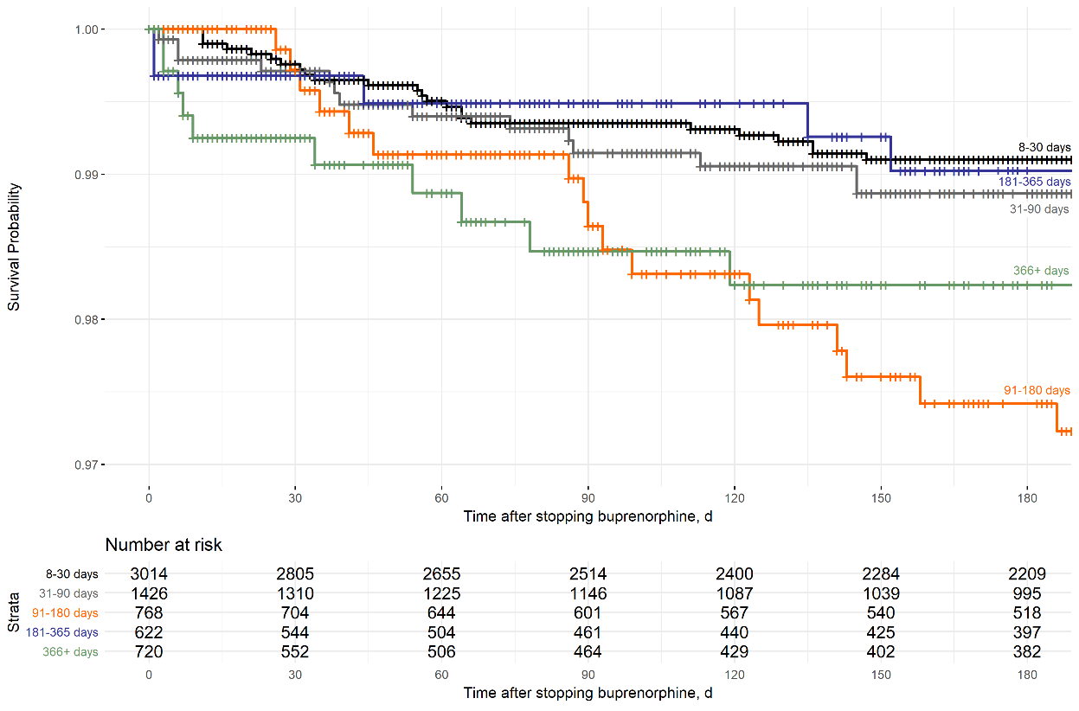
Survival curves for first 180 days of treatment
8-30 days
181-365 days
31-90 days
>365 days
91-180 days
Notes:
People treated for 365 days or more had steeper survival drop in first 30 days after treatment
Patints treated for 91-180 days had lower survival than other groups after 120 days

Slide 39
No statistically significant association between buprenorphine length of treatment and all-cause mortality in adjusted and propensity-weighted model
Length of buprenorphine treatment | Hazard Ratio (95% CI)
8-30 days | 1.25 (0.68, 2.31)
31-90 days | 1.59 (0.85, 2.98)
91-180 days | 1.93 (1.00, 3.71)
181-365 days | 0.79 (0.35, 1.82)
> 365 days | 1.00

Slide 40
Model contrasts for all-cause mortality
Contrasts | Hazard ratio (95% CI)
8-30 vs. 31-90 days | 0.79 (0.55, 1.13)
8-30 vs. 91-180 days | 0.65 (0.42, 1.01)
8-30 vs. 181-365 days | 1.57 (0.80, 3.08)
31-90 vs. 91-180 days | 0.83 (0.52, 3.98)
31-90 vs. 181-365 days | 2.00 (1.01, 3.98)
91-180 vs. 181-365 days | 2.42 (1.19, 4.95)

Slide 41
Crude opioid overdose rates (fatal and non-fatal) by length of time on treatment
N=54 opioid overdoses
6112 person-years of follow-up

Slide 42
Higher opioid overdose rates after treatment for 91-180 days compared for greater than a year in adjusted and propensity-weighted model
Length of buprenorphine treatment | Hazard Ratio (95% CI)
8-30 days | 2.10 (0.82, 2.16)
31-90 days | 1.85 (0.70, 2.07)
91-180 days | 2.94 (1.11, 7.79)
181-365 days | 1.19 (0.37, 3.88)
> 365 days | 1.00
*Overdose fatalities available from 4 of 8 sites

Slide 43
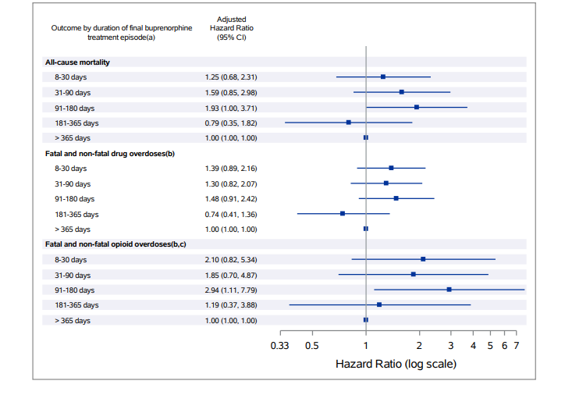

Slide 44
Sensitivity Analyses: All treatment episodes
Results attenuated when used all episodes of treatment, not statistically significant but in same direction as main models

Slide 45
Limitations
Death data limited in some systems
  In-hospital deaths
  Lacking cause-of-death
  In state only
All-cause mortality lacks specificity and may not be the ideal outcome
Pre-fentanyl in some regions – likely to impact retention and mortality
Before elimination of buprenorphine DEA (“X”) waiver requirement to prescribe
Do not know what patient factors or provider/program factors led to discontinuation

Slide 46
Summary
Of individuals who stopped buprenorphine treatment, a majority stopped before 90 days of treatment
Overall high rates of death, with highest unadjusted rate of all-cause mortality among those that stopped treatment between 91 and 180 days
Greatest risk for fatal and nonfatal overdose was among those that stopped treatment between 91 and 180 days compared with >365 days
No “optimal” length of treatment identified: longer appears betters

Slide 47
Future research directions
Explore why there may be a period of vulnerability for stopping between 4 and 6 months of treatment
Currently exploring association between insurance loss and mortality in new multisite study: CTN-0141
Evaluate approaches to enhance retention:
  Enhanced availability of methadone: CTN-0131 is randomized trial of office-based buprenorphine vs. office-based methadone
  Longer-acting buprenorphine formulations
  Reduced monitoring
  Greater medication supply at initiation and higher doses
  Improved management of co-occurring disorders
  Improve buprenorphine tapers to accommodate patient preference without increasing risk

Slide 48
Clinical implications
Communicate to patients: no clear optimal period after which you can safely discontinue buprenorphine treatment
Periodically assess whether patients plan to stop treatment/self-taper
For patients who plan to stop
  Encourage them to remain on buprenorphine treatment for at least 6 months
  Prescribe naloxone

Slide 49



Overdose occurs in the context of individuals’ interactions with institutions across multiple public and private sectors
Healthcare: health systems, insurance companies, hospitals, clinics, Medicaid, opioid treatment programs, Indian Health Service
Communities: housing, workplaces, community-based harm reduction agencies
Criminal legal: prison, jail, re-entry, parole, probation, diversion courts

Slide 50
Health system approaches to prevent overdose
Surveillance
Co-dispense naloxone with opioids
Send patients with risk factors videos on overdose prevention and naloxone
Ensure access to all forms of available treatment
Enhance point-of-care testing for fentanyl
Workplace overdose response and prevention
Support community housing efforts
Anti-stigma campaigns
Binswanger IA et al. J Gen Intern Med. 2022 Aug;37(11):2624-2633; Barnett et al, NEJM 2023

Slide 51
Thank you and questions/comments
Ingrid.A.Binswanger@kp.org

Slide 52
Crude drug overdose rates by length of time on treatment
N=160 fatal and nonfatal overdoses
5892 person-years of follow-up

Slide 53
Adjusted and propensity-weighted model for the association between length of buprenorphine treatment and drug overdose
Length of buprenorphine treatment | Hazard Ratio (95% CI)
8-30 days | 1.39 (0.89, 2.16)
31-90 days | 1.30 (0.82, 2.07)
91-180 days | 1.48 (0.91, 2.42)
181-365 days | 0.74 (0.41, 1.36)
> 365 days | 1.00
*Overdose fatalities available from 4 of 8 sites

Slide 54
Model contrasts for fatal and nonfatal drug overdose
Contrasts | Hazard ratio (95% CI)
8-30 vs. 31-90 days | 1.07 (0.80, 1.41)
8-30 vs. 91-180 days | 0.93 (0.67, 1.31)
8-30 vs. 181-365 days | 1.86 (1.14, 3.04)
31-90 vs. 91-180 days | 0.88 (0.61, 1.27)
31-90 vs. 181-365 days | 1.75 (1.05, 2.91)
91-180 vs. 181-365 days | 1.99 (1.17, 3.40)

