Slide 1
Firearm injury prevention in youth: The ASPIRE Trial at Kaiser Permanente Colorado and Henry Ford Health
Health Care System Research Network Scientific Data Resources Forum
Jennifer M Boggs, PhD, MSW
Research Investigator
Kaiser Permanente Colorado Institute for Health Research

Slide 2
Disclosures
Research reported in this presentation was supported by the National Institutes of Mental Health under award number R01MH123491 (Beidas). The content is solely the responsibility of the authors and does not necessarily represent the official views of the National Institutes of Health.
Notes:
The research I present was supported by an R01 from NIMH with Rinad Beidas as the PI. And what I present represents my own views and not NIHs.

Slide 3

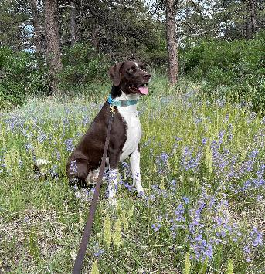
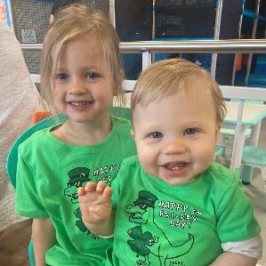
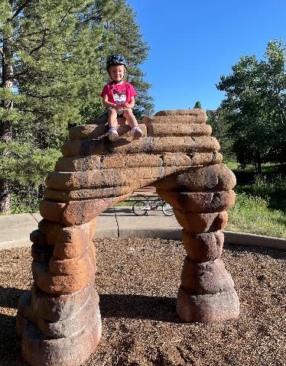
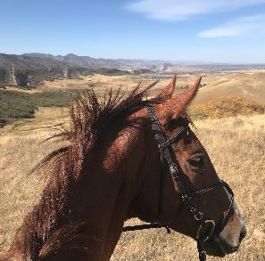
What I do when I’m not working
Notes:
Just so you know a little bit more about me as a human being and my current life context.

Slide 4
Agenda
Background on youth firearm injuries
Implementation strategies for firearm injury prevention
Firearm injury prevention in pediatric medical settings
Recommendations for discussions with patients
Universal pediatric prevention – ASPIRE Study
Questions
Notes:
Overall we will talk about what we know and then what we don’t know and research that is underway.

Slide 5
Background on Youth Firearm Injuries

Slide 6
Youth firearm injuries
Since 2020, firearms are the LEADING cause of death for children 1-17 years of age in the United States.
From 2018 – 2022, there were 956 firearm deaths in Colorado and Michigan among youth 1-19 years (CDC Wonder).
  Colorado = 50% suicide, 47% homicide, 3% accidental
  Michigan = 32% suicide, 66% homicide, 2% accidental
Notes:
While the number of firearm deaths has risen, the rise follows the population growth, such that the rate overall has remained steady in recent years. With exception of a 30% increase in gun homicide in 2020, awaiting the final death information from all states to see if this trend continued in 2021 or was more of a pandemic and social unrest effect from 2020.
A note about data on firearm injuries.
A lot of organizations have pro gun-control or a pro gun-rights bias, so it is important to always consider the source of any statistic that you see on firearm injuries.

Slide 7
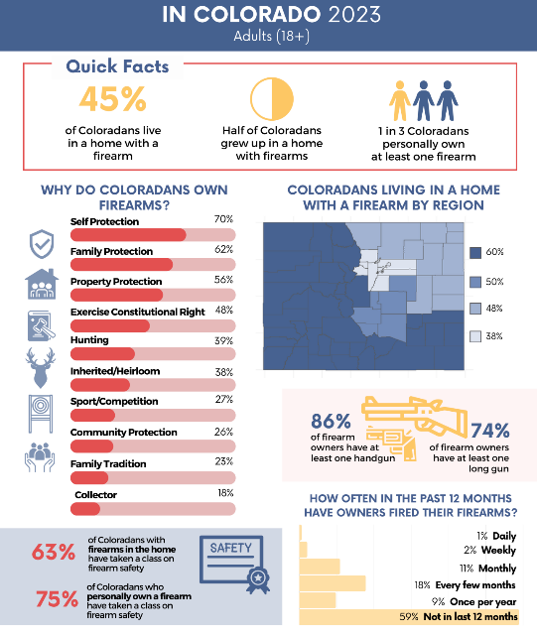
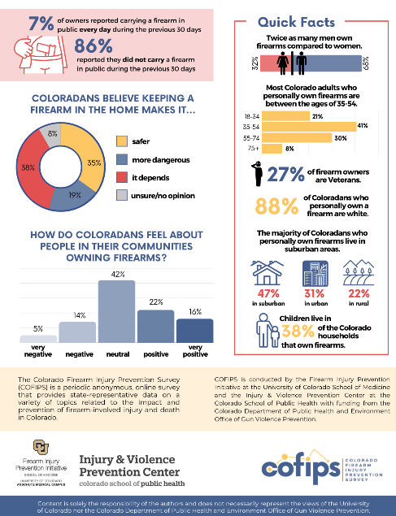
Notes:
The Colorado Firearm Injury Prevention Survey (COFIPS) is an anonymous, online questionnaire that provides comprehensive, Colorado-specific data and insight into the impact and prevention of firearm-involved harms in our state.
Contact – Erin Kelly – on your faculty here.

Slide 8
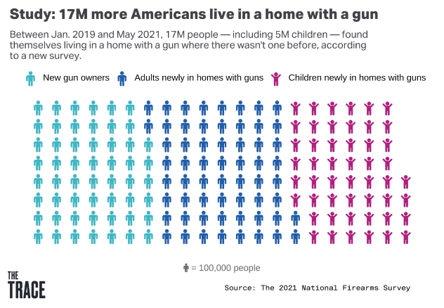
In the wake of COVID-19 and social unrest of 2020 - many families purchased new firearms

Slide 9


In Colorado, 6 in 10 families store their guns unloaded and locked
Source. COFIPS Survey
Notes:
38% of children live in a home with a firearm, and of those 60% are storing them in the safest possible way – locked and unloaded.

Slide 10
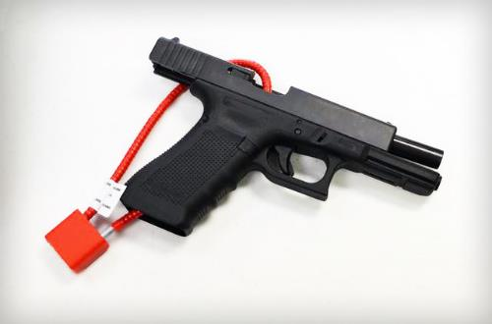
A 20% increase in safe firearm storage could prevent up to 32% of firearm deaths in youth, including suicide
Source. Monuteaux et al 2019. JAMA Pediatrics.

Slide 11
Firearm injury prevention in pediatric medical settings

Slide 12
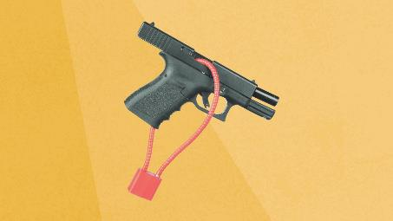
How do we reduce firearm injuries in youth?
Root cause interventions
  Suicide – behavioral health interventions (Zero Suicide)
  Homicide – addressing racism and trauma in disenfranchised communities (The HAVI)
  Accidents – education on safe storage and handling of firearms
Safe storage interventions in health care settings
  Mixed evidence on whether counseling alone increases safe storage.
  Counseling plus lock is more effective.
https://zerosuicide.edc.org/
https://www.thehavi.org/

Slide 13
Primary vs. Secondary Prevention
Primary
Secondary
All children in primary pediatric care (e.g., well-visits)
Screening?
Counseling is generally briefer than what you would do for secondary prevention
Higher-risk children/families
Emergency/inpatient settings
Suicide risk factors identified
Recommendation is to screen for firearm access and account for location of all firearms the child could access.
Notes:
Briefer because there isn’t time do to intensive conversations with all kids and it may not be very acceptable either, seem overly intrusive.

Slide 14

ASPIRE Study
S.A.F.E. FIREARM Program
Universal Prevention in Pediatrics

Slide 15
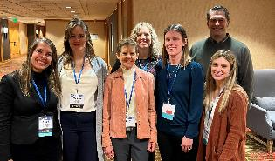
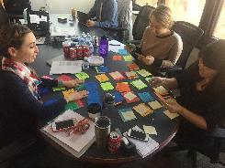

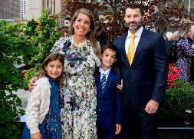
Teams that made this work possible
Jennifer Boggs, PhD, MSW
Arne Beck, PhD
Debra Ritzwoller, PhD
LeeAnn Quintana, MSW
Leslie Wright, MA
Matthew Daley, MD
Ruth Bedoy, BS
Jason Lyons, MA
Blythe Dollar, MPH
Valerie Paolino, BA
Megan Baldwin, BS
Hector De Leon, MD
Nicole Erwin, MD
Lisa Whitesides, MD
Joseph Craig, MD
Daniel Jones, MD
Jordan M. Wright, MD
Robyn Nolan, MD
David R. Thomas, MD
Alan J. Kroll, PT
Emily McGarvey, RN
Brian Ahmedani, PhD, MSW
Melissa Maye, PhD
Celeste Zabel, MPH
Marisa Elias, MD
Bridget McArdle, DO
Shiling Zhang, MS
Joslyn Westphal, MPH
Christina Johnson, MPH
Mallika Pandey, BA
Katy Bedjeti, MSW
Adina Lieberman, MPH
Katelin Hoskins, PhD
Courtney Wolk, PhD
Shari Jager-Hyman, PhD
Kristin Linn, PhD
Steven Marcus, PhD
Alison Buttenheim, PhD, MBA
Melissa Martin, MS
Dylan Small, PhD
Amelia Van Pelt, PhD, MPH
Courtney Gregor, MSEd
John Zeber, PhD
FACTS Consortium
Molly Davis, PhD
Nathaniel Williams, PhD
Shari Barkin, MD
Geoffrey Curran, PhD
Amy Pettit, PhD
Joel Fein, MD
…and many more!

Slide 16

S.A.F.E. Firearm Program
Safety Check
S.A.F.E Firearm
Bundle of violence prevention strategies
  Screening
  Conversation
  Locks
Unintentional injury (ages 2-11)
RCT (2002-2006) found firearm component doubled odds of secure firearm storage
Firearm focus only
  Conversation
  Locks
Universal suicide prevention (ages 5-17)
Brief (<1 minute)
Adaptation
Source. Barkin et al (2008). Pediatrics; Davis et al (2021) Acad Peds. Hoskins et al (2021). JARC.
Notes:
Evidence informed/adapted program.
Media use, timeouts, firearm safety.
Adapted by interviewing a variety of informants including pediatricians at HFH and Baylor, patients, firearm community groups, owners and safety experts. Piloting the program in Texas and HFH.

Slide 17

S.A.F.E. Firearm Program
S.A.F.E. Firearm is an evidence-based secure firearm storage program that is delivered by pediatric clinicians to all parents of youth ages 5-17 during the well-visit, regardless of firearm ownership or endorsement of a screening question.
Brief conversation with a harm reduction lens
Free cable locks
Notes:
All clinics received program materials, training, and quarterly check-ins.
Clinics randomized to facilitation receive more support for implementation. The study is examining whether practice facilitation increases the uptake of this program or if implementation as usual is sufficient.

Slide 18
Safe storage behavior
AAP calls this “Good, Better, Best”
Move parents to safer options
Least Safe
Most Safe
Loaded, unlocked
firearm next
to parent’s bed
Locked, unloaded, ammo locked and stored separately
Firearm unlocked and unloaded; ammo available
Firearm locked up and loaded (quick access safe).

Slide 19
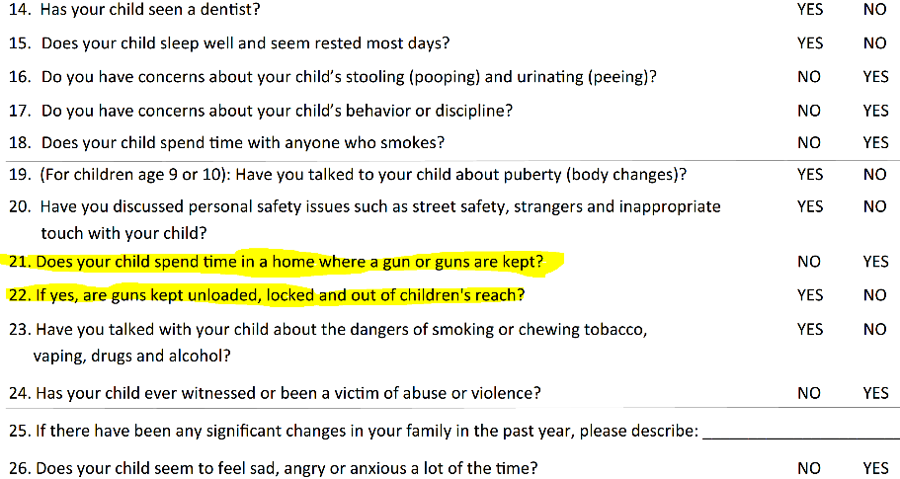
Peds screening questions
Notes:
~10% of parents endorse the firearm access question compared to 40-50% of CO households having firearms.

Slide 20
Empirical evidence for the universal approach
Comparing three assessments of firearm access and storage behaviors in homes with children
 | N | Response rate | Firearm access | Firearm secured
KPCO Well-visit questionnaire | 14891 | 99.90% | 29% | 98%
ASPIRE Study Online Only | 39,921 | 33% | 41% | 81%
COFIPS anonymous community survey | 1520 | n/a | n/a | 82%

Slide 21
SCREENING IS AN OPPORTUNITY TO START A CONVERSATION
SCREENING IS NOT FOR WEEDING OUT PATIENTS WHO DO NOT NEED SAFETY COUNSELING
Notes:
Part of training is that kids can encounter firearms outside of the home, especially at relative, neighbors, or close friend’s homes.
Reason we made this decision was based on our assessment of the data from our screening questionnaire compared to data from community surveys like COFIPS – our internal screening questionnaire showed substantially lower rates of ownership, so that means that Kaiser patients have lower rates of ownership than other coloradans (unlikely considering KPs population looks demographically just like the rest of Colorado). Or parents are under-reporting firearm ownership on that questionnaire.

Slide 22
Recommendations for discussions with patients
Normalize by nesting it with other safety issues.
  Discuss firearm safety with everyone, regardless of firearm ownership.
Focus concern on child safety
  Similar to seat belts in cars
  Highlight firearms as the leading cause of death for children now
Practice or role-play the conversation
Notes:
Non-judgement, non-judgement, non-judgement.

Slide 23
Recommended wording for firearm safety counseling
Say this….
Not this….
Responsible firearm owner
Control access
Prevent unauthorized access
If firearms are present in your home, how are they stored?
I talk with all my patients about firearms
Assault weapon
Without context setting: are there firearms in your home?
I’m afraid of guns
I don’t really know anything about guns
The safest home is one without a firearm *unless you are talking to a patient considering a first-time purchase
Notes:
Dr. Maya Haaz

Slide 24
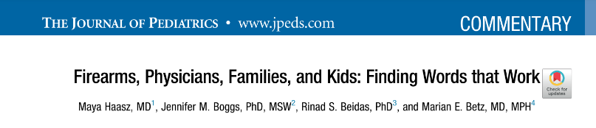
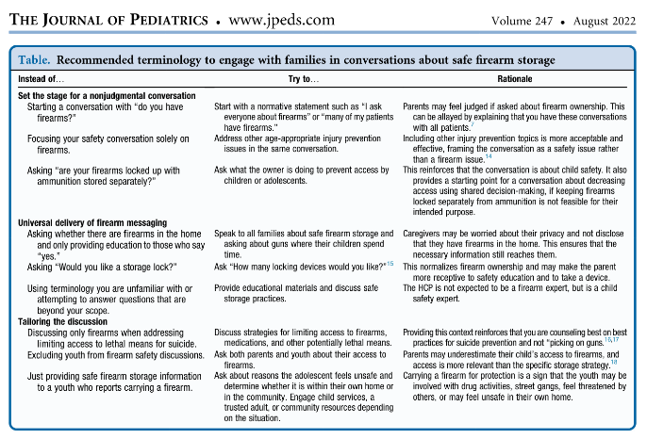

Slide 25
Implementation Strategies

Slide 26
What are implementation strategies?
“Implementation strategies are methods or techniques used to improve adoption, implementation, sustainment, and scale-up of interventions” (Powell et al, 2019).
  Single or multi-component
  Target internal (e.g., provider) or external (e.g., financing) factors
Notes:
Single component strategies rarely are enough, but not always. If it’s a financial strategy like the Medicare five star program with big $$ attached to it, that can be enough.
But typically internal provider focused strategies like trainings, printed materials, engaging champions aren’t typically enough to see sustained practice changes.

Slide 27

ASPIRE trial tested two implementation strategies
Nudge condition
Nudge+ condition
Typical strategies:
  30-minute training webinar, plus 6 videos from AAP
  2-page clinician guide
  Patient posters in exam rooms
  2-page patient handout in exam room
Enhanced strategy
  EHR nudge - Firearm Safety Smartlist in well-visit template
Cable locks
Everything in Nudge
Practice facilitation
American Academy of Pediatrics Firearm Safety Counseling Training Videos: https://www.aap.org/en/patient-care/gun-safety-and-injury-prevention/safe-storage-of-firearms/
Notes:
Multi-component strategies, but the mail

Slide 28
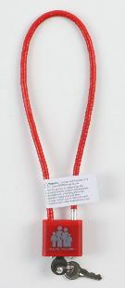
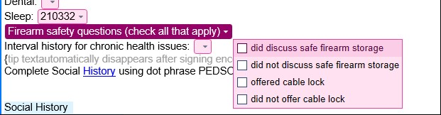

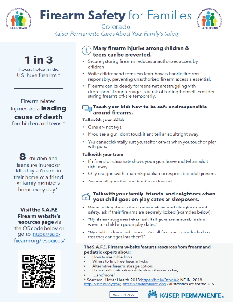
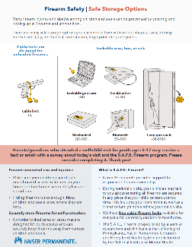
Cable
locks
Firearm Safety SmartList
Posters
Handouts
Notes:
Training, clinician guide
Feedback:
1 minute intervention. 20 seconds to 10 minutes (rare).
Baskets and cable locks are a conversation starter
Tailoring based on age of child; 5-9 year olds = accident prevention, 10+ suicide and accident.

Slide 29
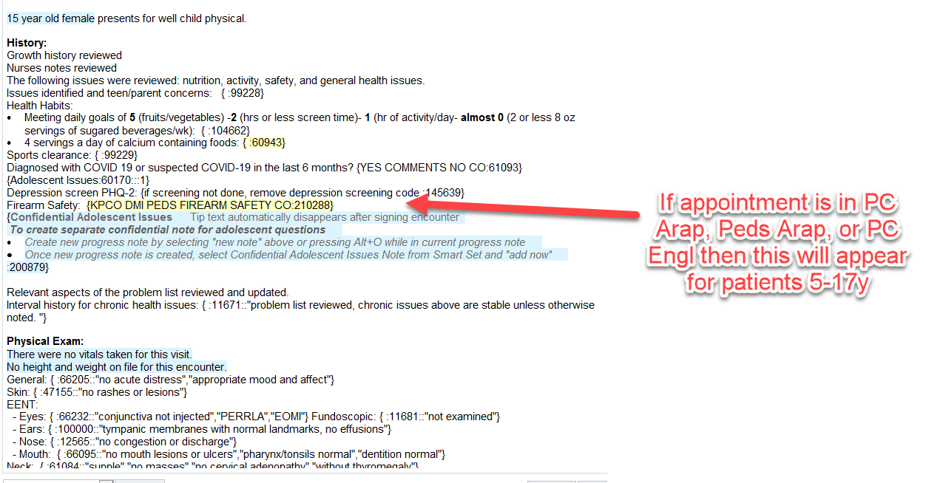

Slide 30


Facilitation
Delivered by MA- or PhD-level study team member employed by the health system
Activities included:
  Developing implementation plan
  Example: meeting with physician champion to plan for S.A.F.E. Firearm delivery at their clinic
  Coaching & instruction
  Example: Reminders about proper S.A.F.E. Firearm delivery
  Providing audit and feedback & updates
  Example: sharing S.A.F.E. Firearm delivery numbers with each clinic

Slide 31
Hybrid type III effectiveness implementation trial – longitudinal cluster RCT
30 clinics
15 clinics
Nudge
Nudge + 1 year facilitation (Nudge+)
15 clinics
Source. Beidas et al. (2022), Imp Sci
Notes:
Used co-variate constrained randomization to balance clinic sizes, proportion Medicaid, and stakeholders between conditions. Anticipated we would be working with about 151 clinicians and 40,000 youth.
We also conducted qualitative interviews with clinicians and leaders after the implementation year to understand how it went.

Slide 32
Outcomes
Primary – implementation
Secondary - effectiveness
Reach – defined by proportion of well-visits within each condition that received safety counseling + lock offered
Parent storage behavior – proportion of parents who were not storing firearms securely to start who changed their behavior to store more securely
Secondary – mechanisms and fidelity
Cost analysis
Qualitative interviews with leaders and clinicians
Clinician survey
  Moderators – clinician attitudes towards suicide prevention, org climate, leadership qualities
  Mediation - clinic adaptive reserve
Total costs to implement in each condition
Cost effectiveness per patient reached for practice facilitation

Slide 33
Parent Survey Recruitment Methods
Randomized intensive recruitment batches
    Stratified sample (by age, clinic size, race) of 50 individuals every 2 weeks
    3 rounds of calls, automated texts, emails, patient portal messages (HFH), and mailings (HFH)
    2,650 patients received intensive recruitment with an 36.8% response rate
Larger automation-based recruitment batches
    3 rounds of automated texts and emails sent via REDCap
    37,271 patients received automated recruitment with an 12.5% response rate
Notes:
We used a parent survey to determine fidelity of S.A.F.E. Firearm delivery at well-visits (to see if clinician documentation matches parent reported delivery) and to assess changes in firearm storage behavior.
Impetus for why we used this method? This mixed outreach method allowed us to navigate resource constraints while achieving a high response rate in a large sample.
We implemented a recruitment method that would allow us to reach our targeted N overall, and a higher response rate in a smaller sample. We outreach to a new recruitment batch every 2 weeks via 3 rounds of calls, automated texts and emails, patient portal messages, and mailings. The remaining patients are sent efficient automated outreach via RedCap.
We are working with a biostats team at University of Pennsylvania, Steve Marcus and Kristin Linn to use this innovative new approach. Since we oversampled parents for intensive outreach to ensure adequate representation in our survey response and saw a higher response rate in the intensive outreach group compared to the automated outreach group, we needed to adjust the results. At a high level, we will adjust for the different intensity of methods used for outreach among R/E minorities, with a GEE model using inverse probability weighting. The weights will be defined as the predicted value of response given outreach method and sampling criteria (e.g., race, clinic size) multiplied by the predicted probability of being selected for outreach given sampling criteria (e.g., race, ethnicity).

Slide 34
Clinical significance threshold
Before trial launch, we gathered input from clinicians and health system leadership to identify what they would consider a clinically meaningful difference
10%

Slide 35
Reach at HFH and KPCO during the 1-year trial
Baseline
27%
2%
44,467 visits
54% received counseling, 34% were offered locks, 34% received both

Slide 36
Reach (counseling + locks) by study arm
Preliminary finding:
Patients presenting to clinics receiving facilitation (i.e., Nudge+ clinics) were 2.2 times more likely to receive S.A.F.E. Firearm (41% vs. 28%)
Notes:
How to explain this: After adjusting for clustering within clinic and covariates included in the model, those in Nudge+ were approximately 2.2 times more likely to receive the intervention than those in Nudge
The more rigorous model-based result is the risk ratio of 2.2; i.e., the RR are outputs of the GEE model
Caveat for the %s for each arm: The %s for reach/counseling in each arm are raw %s and not accounting for clustering (i.e., raw numbers of total yeses divided by total eligible in the entire dataset)

Slide 37
Clinical Effectiveness:
Did you make firearms more secure after your visit?
Excluded from the analysis:
N=1749 (31%) reported Firearms were already stored securely
N=3063 (57%) reported N/A (e.g., don’t have firearms)
N=408 (9%) did not complete the question
Notes:
71% changed their behavior. 24% changed among those who did not. Our survey response rate was about 36%, so we may have representation issues. Among survey respondents who
This doesn’t look at parents who took locks that gave them away to family members, just those who said they had firearms and weren’t storing safely to start.

Slide 38
ASPIRE Trial Conclusions
There was substantial practice change in both arms in both systems across a diverse patient population using typical implementation practices with an EHR nudge.
Practice facilitation significantly boosted the uptake.
Among those who were not storing firearms securely to start, parent report indicates that those who received S.A.F.E. Firearm were far more likely to change their behavior following the visit.

Slide 39
Limitations
The clinical effectiveness of S.A.F.E. Firearm to prevent firearm injuries in youth is not yet established as it would need to be implemented across a larger sample to be powered on rare injury/death outcomes.
An analysis of data from our pilot clinics showed that providers may have been more likely to deliver S.A.F.E. Firearm to parents of male patients and to racial and ethnic minorities, which may indicate a bias that should be addressed in future implementations of this program.
S.A.F.E. Firearm hasn’t been tested beyond these two health systems, and the generalizability of our findings is unknown.

Slide 40
Opportunities
Leverage positive results from the trial to expand S.A.F.E. Firearm to other pediatric settings
Expand “nudges” to other clinical content areas for underutilized clinical recommendations to increase uptake.
Grant under review (SCALE ASPIRE) to adapt and scale up S.A.F.E. Firearm to adult populations in adult primary care and OB-GYN.

Slide 41
Firearm safety counseling training resources
American Academy of Pediatrics Firearm Safety Counseling Training Videos: https://www.aap.org/en/patient-care/gun-safety-and-injury-prevention/safe-storage-of-firearms/
Bulletpoints project clinical training: https://www.bulletpointsproject.org/

Slide 42
References
Beidas, R. S., Ahmedani, B. K., Linn, K. A., Marcus, S. C., Johnson, C., Maye, M., ... & Boggs, J. M. (2021). Study protocol for a type III hybrid effectiveness-implementation trial of strategies to implement firearm safety promotion as a universal suicide prevention strategy in pediatric primary care. Implementation science, 16, 1-16.
Health Care Systems Research Network: https://hcsrn.org
CDC Wonder: https://wonder.cdc.gov/controller/datarequest/D76;jsessionid=42DAE8883D152E2A8C27E93FE406
Colorado Firearm Injury Prevention Survey (COFIPS). University of Colorado. https://www.cofips.org/
Kutsch, T. Since 2019, Millians More Americans Live in Homes with Guns. The Trace. 12.21.2021. https://www.thetrace.org/newsletter/since-2019-millions-more-people-live-in-homes-with-guns/
Monuteaux, M. C., Azrael, D., & Miller, M. (2019). Association of increased safe household firearm storage with firearm suicide and unintentional death among US youths. JAMA pediatrics, 173(7), 657-662.
Zero Suicide. Educational Development Center. https://zerosuicide.edc.org/
Health Alliance for Violence Intervention (HAVI). https://www.thehavi.org/
Powell BJ, Fernandez ME, Williams NJ, Aarons GA, Beidas RS, Lewis CC, McHugh SM and Weiner BJ (2019) Enhancing the Impact of Implementation Strategies in Healthcare: A Research Agenda. Front. Public Health 7:3. doi: 10.3389/fpubh.2019.00003
Haasz, M., Boggs, J. M., Beidas, R. S., & Betz, M. E. (2022). Firearms, physicians, families, and kids: finding words that work. The Journal of Pediatrics, 247, 133-137.

Slide 43
Jennifer.M.Boggs@kp.org
http://kpco-ihr.org/bio-boggs.html
@Jennifer55577268
Notes:
Introduce self

