Slide 1
From ACT Tracking to ACT Central: Changing an Operational Database in Motion
A presentation about the Adult Changes in Thought Study
Dustin Key, Luesa Healy, Jeremiah Litondo
September 2024

Slide 2
Topics to Cover Today
Part One
Overview: Project Overview, Operational Database Development
Dustin Key
Part Two
Lucid Charts: Introduction, How we Use in Development Effort, and Demo.
Jeremiah Litondo
Part Three
ACT Central: Database Architecture Decisions
Luesa Healy

Slide 3
Adult Changes in Thought (ACT) began in 1994
A U19 with Rich Data – A Living Laboratory
And cohort management by ACT Tracking,and five other databases, migrating to ACT Central.
N=~ 2,000 Active Participants visiting on biennial schedule. Weekly random sample, age >=65.
Following the life course in order to understand dementia and developing ways to treat and prevent.
ACT Study Home (actagingresearch.org)
Principal Investigators
Linda McEvoy, PhD Kaiser Permanente Washington Health Research Institute
Paul Crane, MD, MPH University of Washington
Andrea LaCroix , PhD University of California, San Diego
Partnership with National Institute on Aging NIA: U19AG066567

Slide 4
Thank You to everyone working with ACT to upgrade our operational database
Core ACT Central Development Team
Chay Davis (PM) | Dustin Key (PM)
Serah Kimachia (UI Dev) | Bonnie Lind (Reqs and Testing)
Jeremiah Litondo (UI Dev) | Sundary Sankaran (PM)
Kristin Delaney (SSRS) | Luesa Healy (DB Dev)
Pamela Shaw (Lead) | Rod Walker (Lead)
User Acceptance Testing, Clinical Core Support, Project Customers
Roxanne Muiruri | Beverly Schaaf
Nora Van Doren | Beth Pope
Tiffany Gaines | Leonardo Colemon
Julie Cooper
PC Support, Migration, and Administrative Support
Shellie Jacobsma, Daniel Riness, Rebecca Ziebell, Tyler Ross, KatieRose Johnson
Ashley Bester, Lou Ferraro, Curt Brantley, Jon Brown, Tim Nguyen, Tracie Nettles, Paromita Sen, Eliot Trainer
Survey Research Project
Matt Nguyen | Laura Sandall

Slide 5
Cohort Management over a Participant’s Life Course
Blood Samples
EYE ACT
BASELINE VISIT, FORMS
CONSENTS
_
ACT_Tracking (Soon ACT Central)
WELCOME PACKET
_
Project 1
BLOOD DRAWS
EYE ACT
RECRUITMENT, SCHEDULING, INCENTIVES
_
ACTIGRAPHY
_
SAMPLING
Forms DBs, SAS AF
NEWSLETTER
_
FUTURE ANCILLARY STUDIES
REMINDER PACKET
_
_
BIENNIAL VISIT, FORMS
_
CHART REVIEWS
30 Years or More
HOME VISIT INFO FROM UW
BIRTHDAY LETTER
EXISTING ANCILLARY STUDIES
STATUS CHANGE
Chart Review
INFO FWD TO UW

Slide 6
Moving ACT Tracking to a Higher Orbit to Realize Efficiency
Collecting many data points over decades
Goal (November 2024) ACT Central replaces Legacy ACT Tracking
Electronic Tracking Sheets. Direct UW access via Workforce Determination
Full Decommission of ACT Tracking Legacy Access Database
ACT Central: Internal Web App / Entity Framework C#
Variable change history and event orchestration eliminating spreadsheets
Modularity with Existing and Future Ancillary Projects
Increase tracking and efficiency in a higher orbit
_
V
_
Current Orbit Around the Data Collection Space
ACT Operations Gains ‘Higher Orbit’ Efficiency
Current Tracking Orbit
Heavy Reliance on Paper
Access Database Still Majority of Function
1 Dev w/ 3 DBs, 1 QA, and 1 Production Server. 2 SSRS servers
Variable History External to User Interface and Coarse Backup
Rescheduling of Patients is External to Database Process
Explaining the Orbit Analogy: is the change in velocity needed to perform a maneuver in space. We need to make sure our resources are enough to achieve the required change in velocity, speed and direction, to upgrade ACT databases while maintaining them.
V

Slide 7
Changing A Database in Motion: Maintenance & Development
Collecting many data points over decades
Maintenance: Controlled and Telegraphed Efforts
Monthly Planned Maintenance Windows
ACT Custom Work Tracker, KPWHRI ACT Infrastructure Inbox
Project Support and Communication
Automation of ETL and Monthly Processes
Role Generalization and Cross Training
Script Promotion Plans (Dev x QA x Prod) *
ACT Tracking
_
Maintain present function
Maintenance and Development are strategy efforts each needed to upgrade our operations databases, while continuing to support the project.
Development: Coordination & Implementation
Script Promotion Plans (Dev x QA x Prod)
JIRA Issue Tracking and Kanban Boards
Development Sprints, User Acceptance Testing, Lucid Charts
Software Development Life Cycle Planning
Project Steering Committee and Core Support and Sponsorship
Strong Partnership with Shellie’s Application Team and Standards, And PC Support!
ACT Central
_
_
Develop to obtain higher orbit.

Slide 8
Maintenance Strategies
Controlled and Targeted Efforts, Cross-Training

Slide 9
Monthly Planned Maintenance Windows
Collecting many data points over decades
Have now completed 18 windows.
Each mid-month we review the change requests we have in the ACT Work Tracker.
We then coordinate plans of which items will be done in 2 weeks, and possibly at the next (6 weeks) with the PM team. Assign work.
Coordinate on Teams during the window.
SU | MO | TU | WE | TH | FR | SA
 |  |  |  | Review Work Tracker and PM Coordination
 |  |  |  | Maintenance Window 2pm-6pm
ASIDE: Considering adding a confirmation here to address changes from the project on already assigned requests primed for implementation this window.

Slide 10
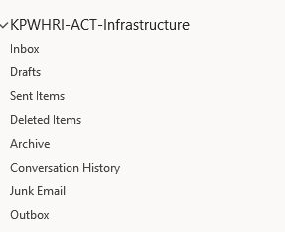
ACT Custom Work Tracker
Collecting many data points over decades
We cloned the Application Team’s work tracker and customized for ACT. This is used in tandem with our maintenance windows.
Requests and communication about work can go through our KPWHRI-ACT-Infrastructure inbox.
This inbox benefits from the visibility of the database team vs. single individual person.

Slide 11
Development Strategies (Briefly)
Coordination and Implementation of Specialized Resources

Slide 12
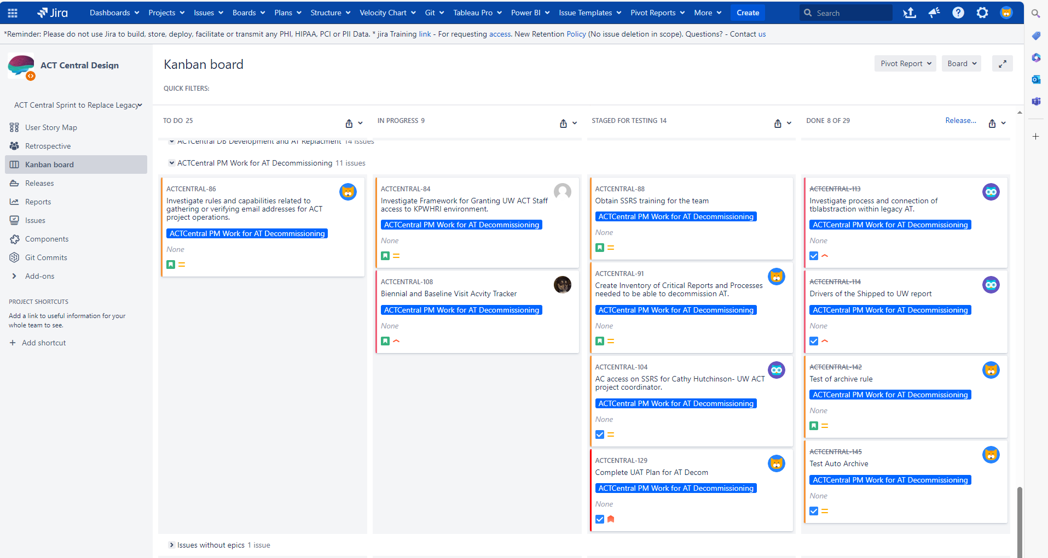
JIRA Kanban
Collecting many data points over decades
We’ve customized our board to have 3 swim lanes:
User Interface issues (UI)
Tends to be Entity Framework Work
Database (DB)
Tends to be SQL script and ETL work
Project Management
Usually more general themes and tasks, coordinating design work with projects.
We’ve created 4 issue states for our Kanban board: To-Do, In Progress, Staged for Testing, Done
The development team working on ACT Central UI has been using JIRA Kanban boards to organize and communicate on issues. With hundreds of individual issues in the software development, it would be very difficult to manage by email or spreadsheet.

Slide 13
Sprints
Open Sprints
Close Sprints
One Week
Monday Developer’s Huddle
Debrief on last week. Open new sprint or continue existing. Reference coordination plan in sprint assignment. Try to add some BYEs to build in flexibility for unknowns.
Friday Developer’s Summaries and Effort Estimation
 | 5/13/2024 | 5/20/2024 | 5/27/2024 | 6/3/2024 | 6/10/2024
UI - Jeremiah | BYE | Subjects in Recruitment Sprint 2 | Subjects In Recruitment Sprint 2 | BYE | Writable TS
UI - Serah | BYE | Accordion Dev | Cog Eval | Cog Eval | Cog Eval
DB - Luesa | BYE | Cog Eval | Prod ETL Sprint Planning | ETL Subjects in Recruit | QA ETL Completeness **
PM - Dustin | Reporting Setup | PM Reporting | PM Reporting | BYE | Birthday Reporting
Operations Events | Consent Review | Orchestration Review |  | Close Cog Eval
Reporting Events | SSRS Training |  | SSRS Training set
Testing Events - Bonnie | Test Consents |  |  | Test Cog Eval | Subjects in Recruitment
PM Events - Chay |  | UW Onboarding |  |  | UW Onboarding
PM Events -Sundary | SSRS config
 |  |  |  |  | (loading QA so it is consistent w/ AT)
Milestones |  |  |  | Subjects in Recruitment Built | Cog Eval Module Built

Slide 14
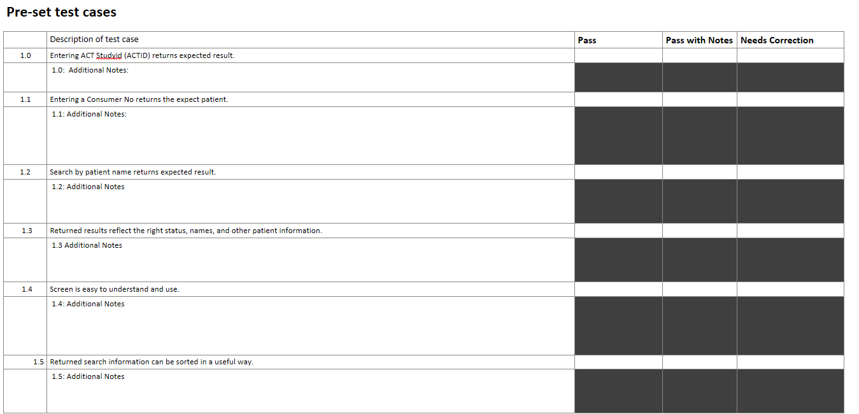
Software Development Lifecycle Planning
ACT Central
Launch 1
Req Gathering
Pre-Recruit
SRP
Servers
Accordion Sprint
UAT
Launch 2
2022
2023
2024
Dividing the new ACT Central testing into 9 sections:
Patient Search
PPT Management Subject Info
PPT Management Status and Track
PPT Visits
PPT Consents
Comments Mod
Cog. Evaluation
Subjects in Recruit
Tracking Sheets
User Acceptance Testing (UAT) Instructions:
Please perform the following use tests listed under ‘Pre-Set test cases’. For each item please choose 1 of the following 3 results:

Slide 15
End Summary Q&A
Changing a Database already in use means it is important to spend resources on addressing requested changes to legacy.
By focusing on separate Maintenance and Development strategies, we help ensure that we can implement the needed changes, reaching the higher orbit. Today we showed just two of our development strategies in detail, using Lucid to illustrate before we code and aspects of our SQL architecture.
As ACT approaches higher orbits, the wonderful experience our patient participants have will get even better. And it will be yet more efficient, increasing the resources the whole project has to try to find and understand more dementia risk factors.
Thank You! Dustin, Jeremiah, and Luesa

