Slide 1
Introduction to the
Virtual Data Warehouse
What it's good for, how it works and how to use it in your research.

Slide 2
Learning Objectives
What the VDW is & isn't
Why it exists
How to
  Use the VDW
  Engage with the implementer & user communities
  Avoid common pitfalls
Where it's documented
How it's governed
Q & A / free-form consulting

Slide 3
The VDW is…
A series of data standards, library code, and automated processes in place at each of the 19 HCSRN sites,
That allow SAS programs written at one HCSRN site to be run at all the other sites
  Quickly, and
  With a bare minimum of site-specific customization.

Slide 4
The VDW is Not…
A centralized database
  There's no secret bunker or secure enclave where you can access all data at once
  Data stay at the originating sites
A means for fully automating data-based research
  VDW is very human-mediated
A replacement for the local data you already know & love.

Slide 5
Why does it exist?
In the earliest days of the (then) HMO Research Network (HMORN), member organizations had no data systems in common.
So multi-org projects hired programmers at each participating site to implement a data pull specification written in plain English.
Post-project: discard the data (!)
Around 2002 the Cancer Research Network (CRN) project uses Infrastructure $ to
  Develop a set of standard, general-purpose datset standards
  Fund the initial efforts to implement those datasets at CRN sites.
  CRN borrows heavily from the already-running Vaccine Safety Datalink project specs.

Slide 6
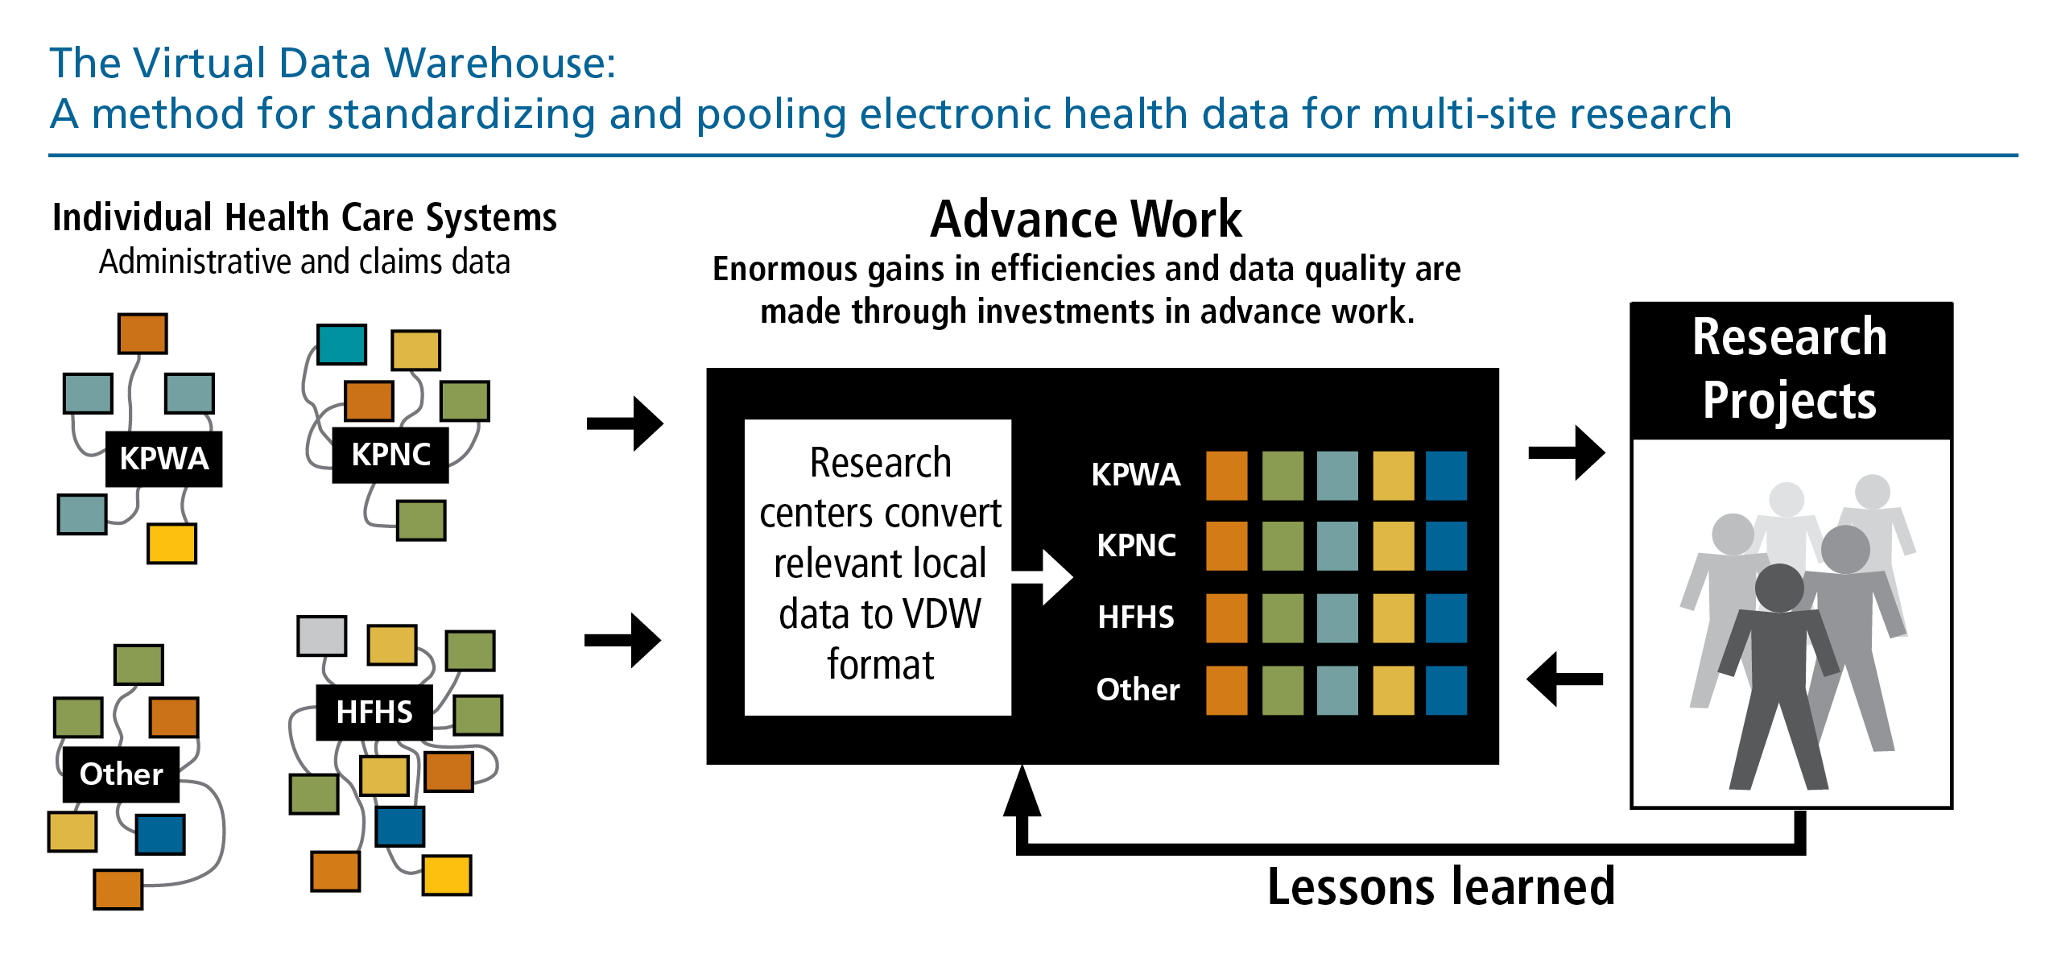
How It Works—Technically

Slide 7
How It Works—In Practice
There's no formal process for taking in inquiries/ solicitations. Nearly everything is generated from inside the HCSRN
Investigators are soft gatekeepers.
  Because the process is so human-mediated, you need humans at the sites willing & able to help.
  Someone to do IRB
  Programmer to run the code, evaluate, and return results
Advice: find like-minded Investigators at the sites you'd like to collaborate with and engage with them early.

Slide 8
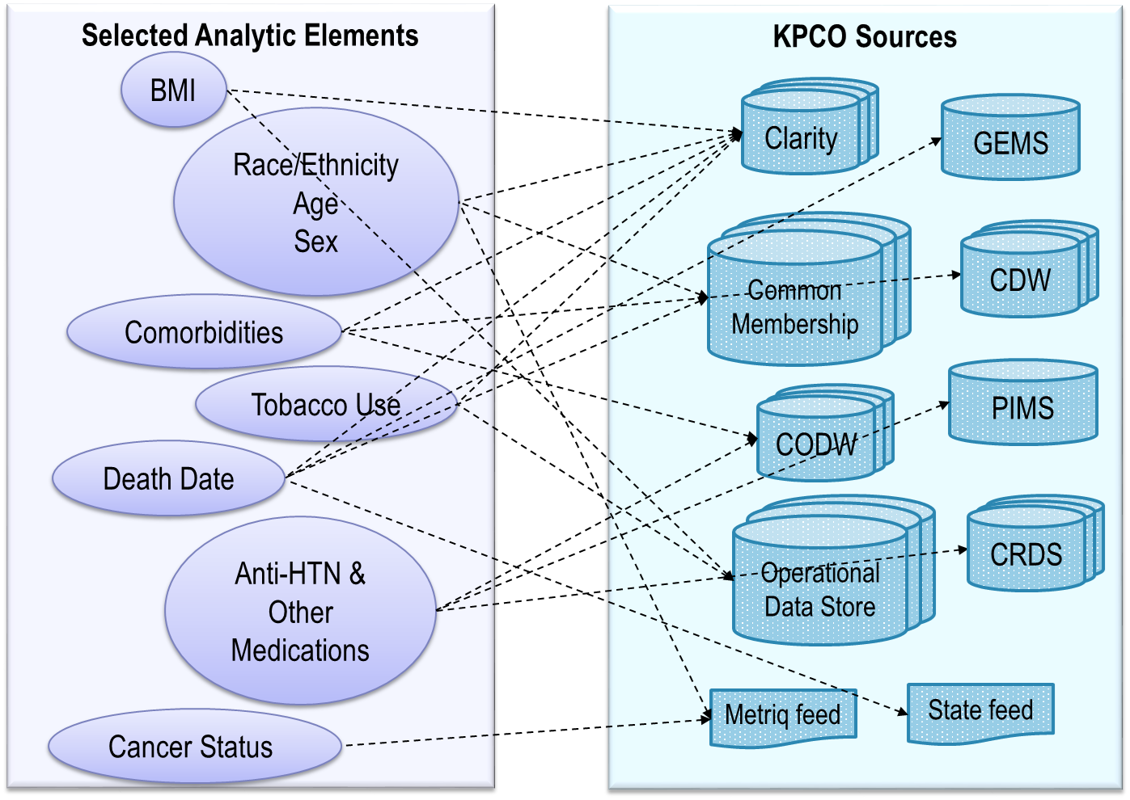
What is necessary to build an analytic variable?

Slide 9
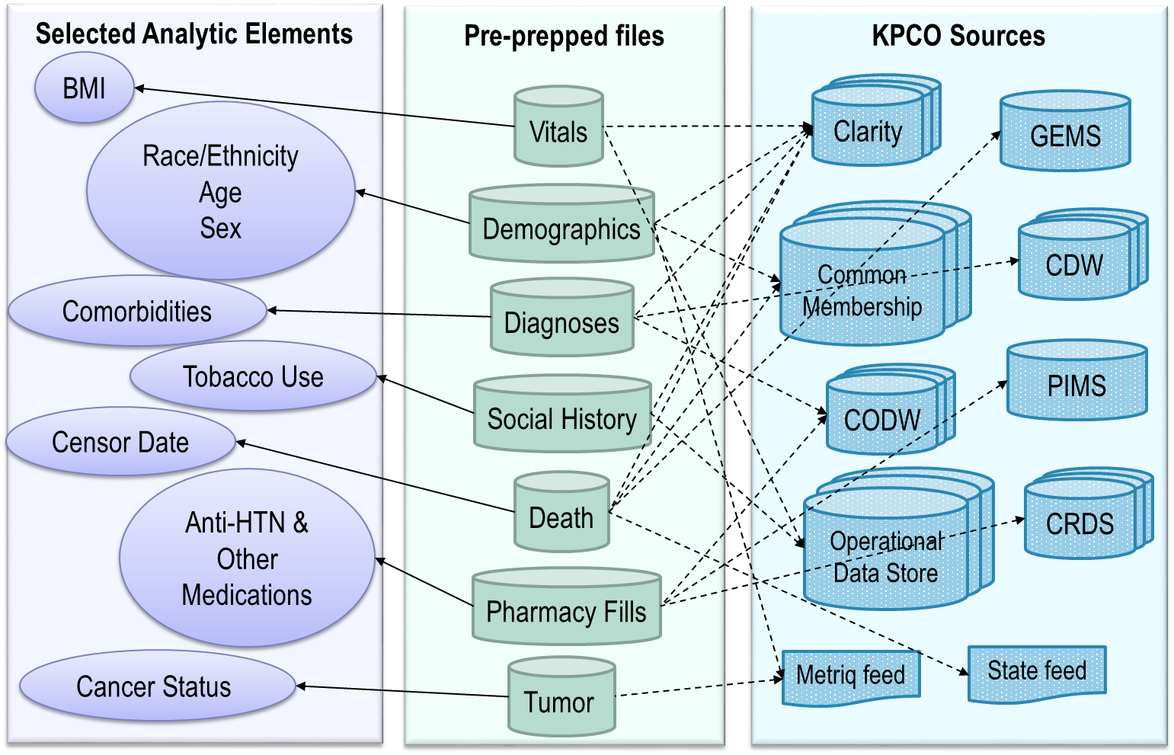
Study Workplans

Slide 10

Cost of a research project pre-VDW
Redundant
Ad-hoc
Potentially poorer quality
Differing interpretations of workplan
Data lessons lost/siloed
Complicated sources
Data discarded at end of project
= EXPENSIVE

Slide 11
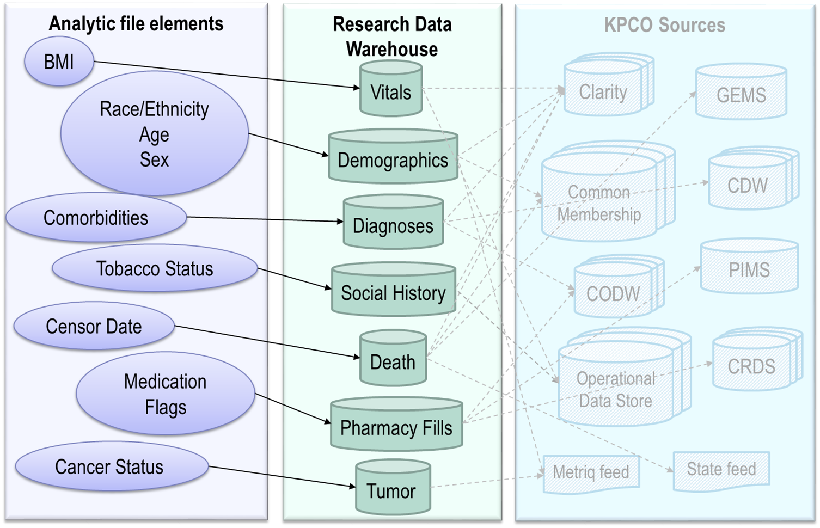
What if…

Slide 12
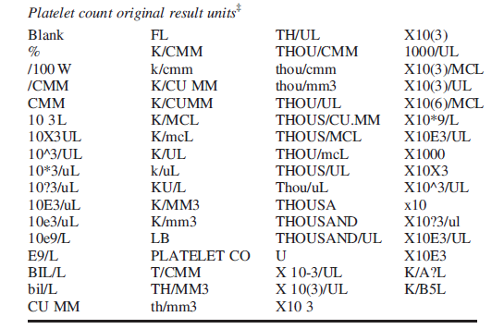
Harmonization: Example #1
Standardized in the VDW to ‘K/UL’ - One thousand per microliter.

Slide 13
Harmonization: Example #2
Bill type
(Facility Claims)
“111”
“112”
Encounter Type Code (EMR)
“3”
“106”
“IP”
"Bundling" of sequential claims, related professional billing, and EMR data
Place of Service
(Professional Claims)
“21”
Internal
Data Mart
“I”
“IP”
All of these codes from disparate systems map to a single aligned concept value of “Inpatient Stay”

Slide 14
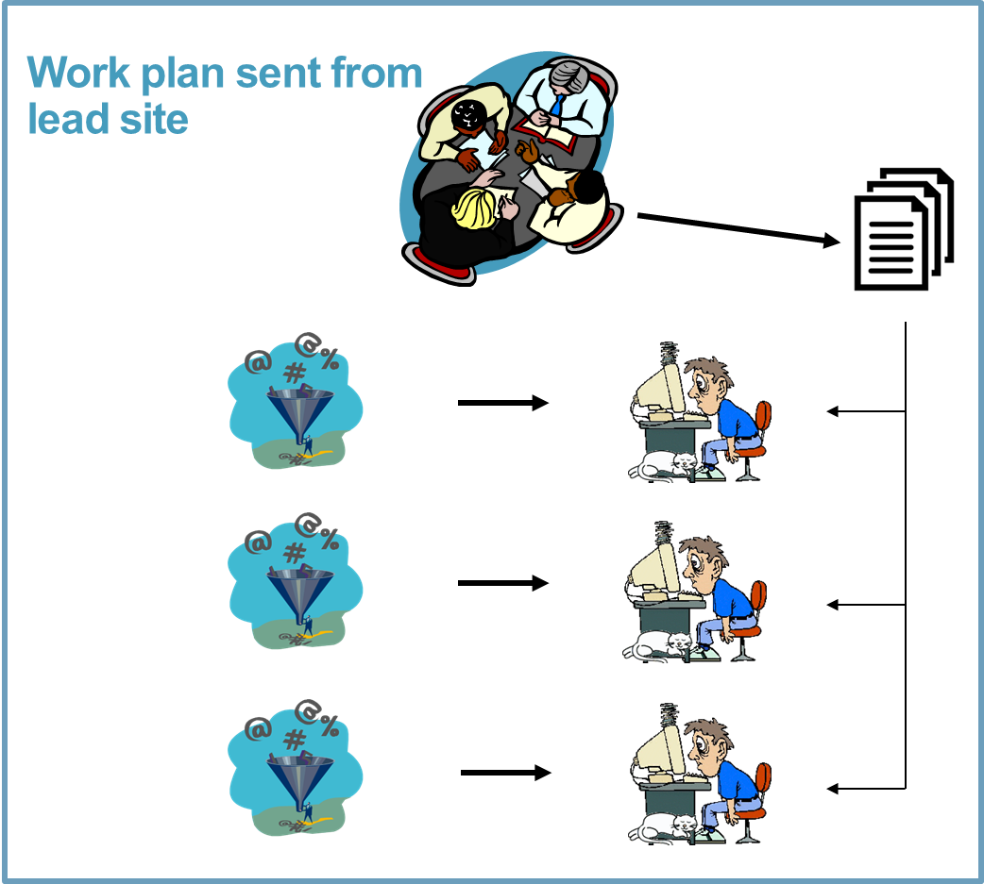
Instead of this:

Slide 15
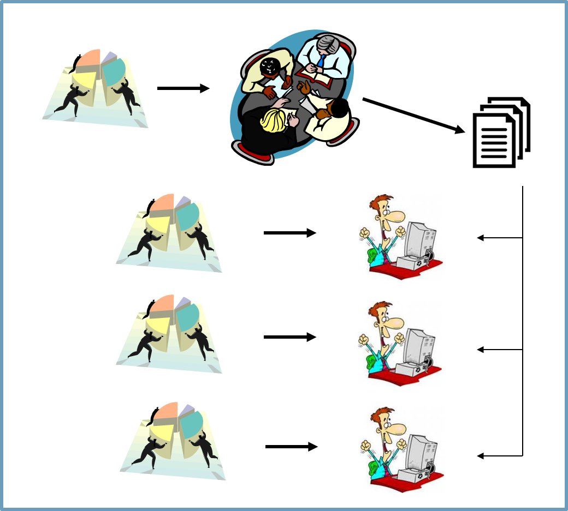

We have this:

Slide 16
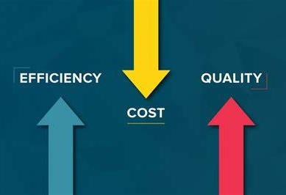
Why use, develop, and enhance the VDW?
  Data pulled and transformed once from the source systems
  Quicker to learn how to use the data
  Easier to write programs for studies
  Highest FTE at lead site, reduced FTE at contributing sites
  Standardized and tested macros and algorithms are shared across HCSRN for QA and routine data tasks

Slide 17
Why use, develop, and enhance the VDW?
Scientific validity
  Replication
  Common definitions and decisions across
  projects and people
  Standardization improves scientific rigor
  by improved consistency and reproducibility.
  Standard code library to draw on
  (e.g. comorbidity indices,
  definitions of continuous enrollment)
  At its best, the VDW is a vehicle for preserving & cumulating
  the benefits/fruits of project-specific work.

Slide 18
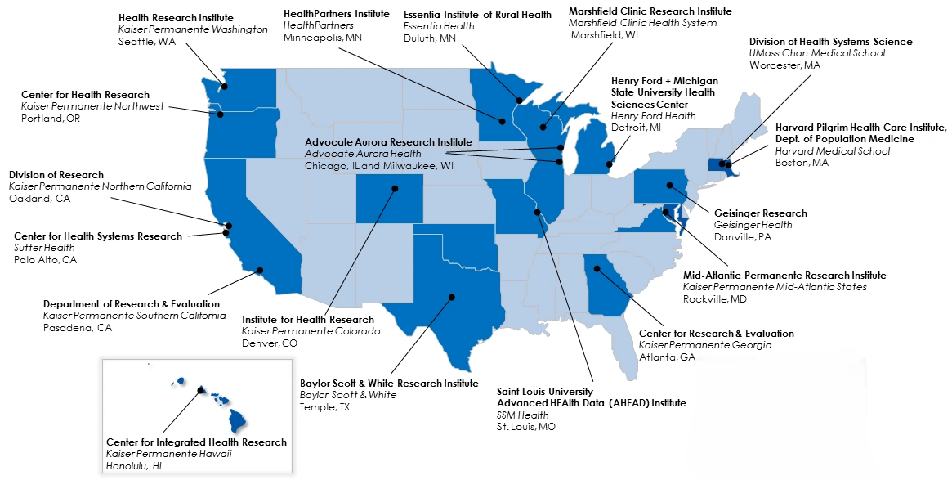
HCSRN Sites

Slide 19
What Data Do We Have?
We have 19 Active Organizations, all of which have implemented 1 or more VDW tables.
There are 10 general data areas (comprising 26 distinct tables).
Enrollment/Demographics (3)
Utilization (6)
Pharmacy (2)
Lab Results (2)
Vital Signs (1)
Death (2)
Social History (1)
Tumor (2)
Census (3)
Patient Reported Outcomes (4)

Slide 20
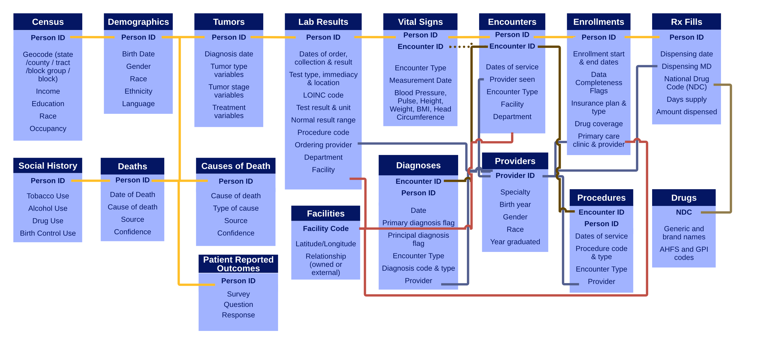
Data Areas

Slide 21
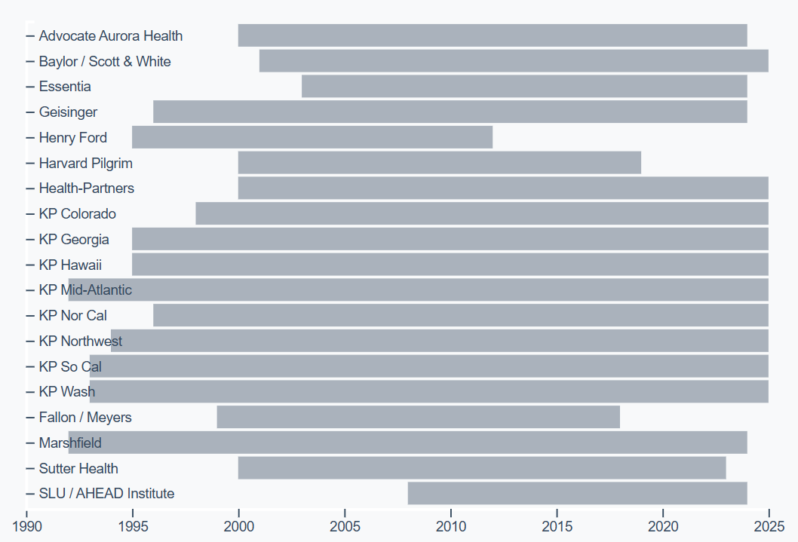
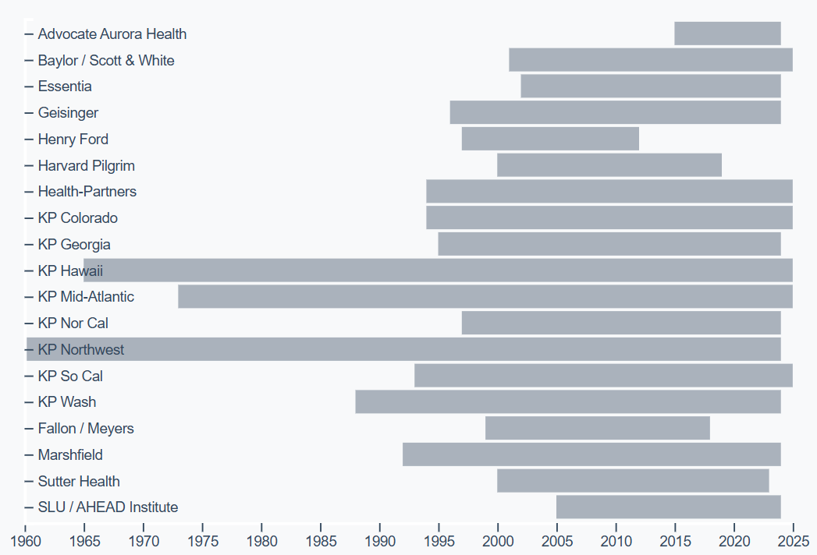
Different Sites' Implementations Vary in Extent
Encounters
Enrollments

Slide 22
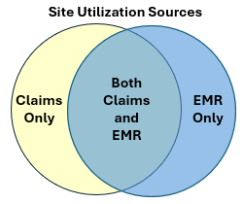
We encourage sites to use "all the data that fits"
Specs are generally laid out to accommodate all compatible data sources, including:
  Legacy (pre-modern EMR) internal systems
  Claims (rx, facility, professional)
  EMR
  Other business/administrative data as
  appropriate for the subject area
Many specs include metadata fields to
indicate provenance
(e.g., SOURCE_DATA in the Encounters Table)

Slide 23

Robust Change Management
As research topics, methods, and workflows evolve, so must the VDW
The VDW works as a collaborative at all levels to understand needs and create new specs and implementation guidelines.
Finalize
Implement
Vote
Discuss
Vet with community
Propose
Proposed spec change

Slide 24
Change Management Comments Requested
For Scientific Users
For Implementers
Can you obtain the information needed for the new variables?
Do you have other useful information in your source data that would not be well accommodated by the proposed changes?
likely to be useful?
Are the new variables proposed
conceptually coherent?
clearly defined?
Can you think of a better way of storing this data for research use?
How valuable is this information to you?
Are the new variables proposed:
conceptually coherent?
clearly defined?
likely to be useful?
How do you expect these changes to affect your current program of research?

Slide 25
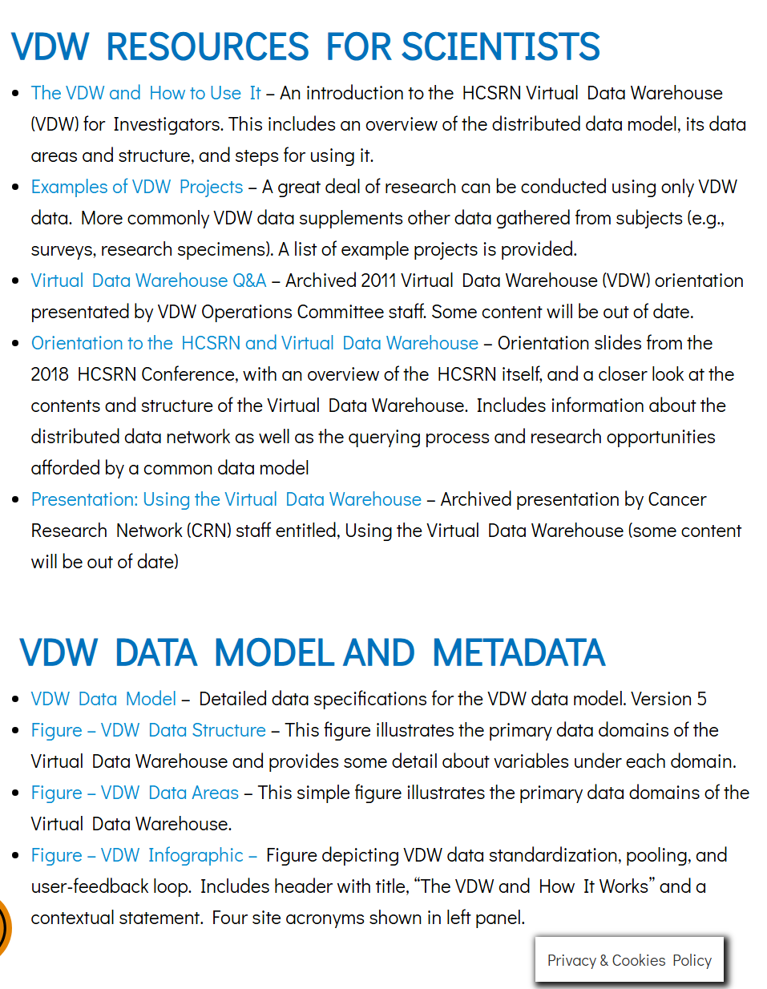
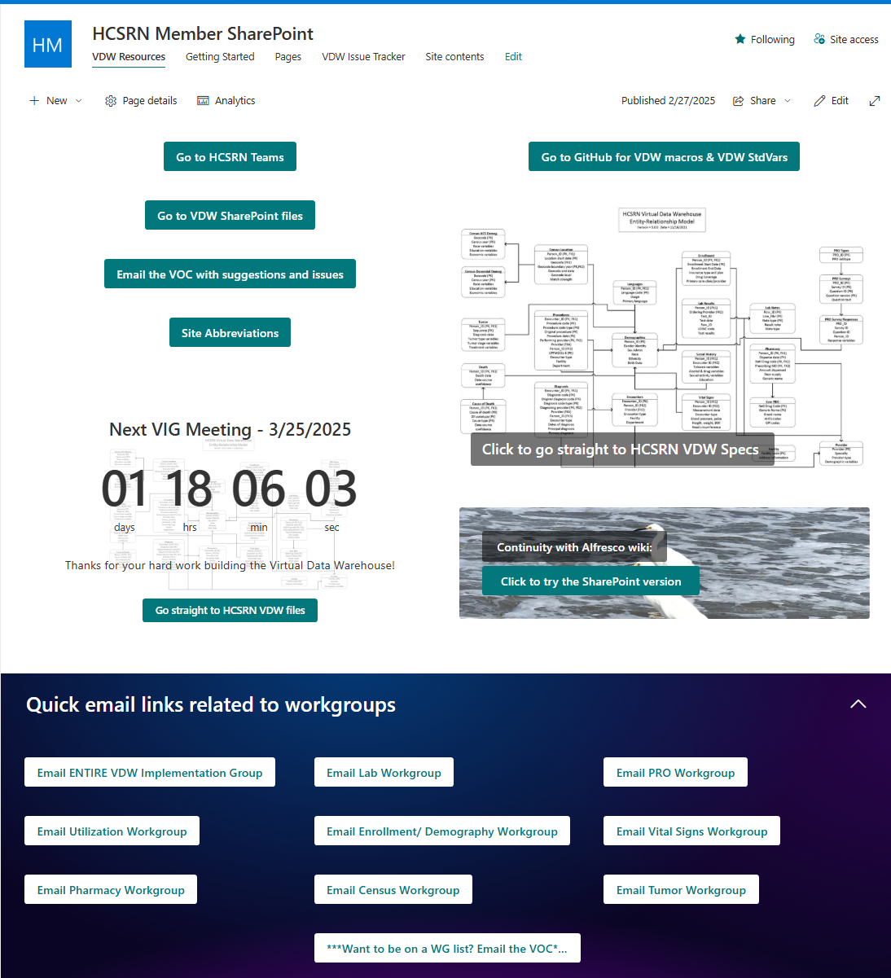
Documentation & Resources
  Public-facing (hcsrn.org)
Members-only

Slide 26

Public Documentation
HCSRN.org's
  Data Resources page: Data Resources | HCSRN Collaborative Research Resources
  VDW Data Model: VDW Data Model | HCSRN Collaborative Research Resources
Includes:
  Orientation to HCSRN and VDW
  Examples of VDW Projects
  Data Model
  Specifications
VDW Data Model

Slide 27

Public Documentation (cont)
We also have several assets on github, including our standard macro library and documentation.
Finally, we have the Implementation Overview page: Virtual Data Warehouse Implementations which shows:
  Sites
  Data Areas
  How far back (and forward) in time each site's implementation goes.
  How often each site updates its VDW files
  Lightweight, unofficial data specifications
Implementation Overview

Slide 28
Members-Only Documentation/Resources
HCSRN VDW SharePoint: https://hcsrnvdw.sharepoint.com/
  The home of the Official VDW Specifications
  E-mail addresses for leadership & workgroups
  Reports of interest
    Cross-site QAs (e.g., enrollment)
    HCSRN Population Characteristics
  QA Issue Tracker
HCSRN VDW Microsoft Teams Instance
  Channels devoted to different data areas
  General channel
  Excellent place to engage with (other) implementers, to ask questions about what you'll find at the sites.

Slide 29
Common Pitfalls Using VDW
Biggest is assuming that all HCSRN sites are like yours.
  Utilization comes completely from claims, or from non-claims.
  We only treat people we insure (or we insure people at all!)
  Vast majority of inpatient stays are at external hospitals.
  We have our own Tumor registry.

Slide 30
More Pitfalls
More “like me” assumptions:
  We run the EPIC EMR, and have the Clarity reporting system.
  Chemo data winds up in Procedures data, not Pharmacy.
Assuming all variables will be populated over all time (e.g., Gender Identity & Sexual Orientation in Demographics are pretty sparse).
Assuming uniformity of data across sites.
  VDW does some assessment, cleaning & normalization, but not as much as most people assume.

Slide 31
Still more pitfalls
Assuming <<some data element you need>> is available in VDW.
  Study the specifications!
In general:
  Go slow.
  Explore.
  Take nothing for granted.
  Don’t hesitate to consult with Yonah and other staff.

Slide 32
How is VDW Governed?
The VDW Operations Committee (VOC) is charged with maintaining and setting priorities for the VDW
  Consists of three people
    Director of Scientific Infrastructure: Mark Jurkovich (HealthPartners)
    VDW VOC Coordinator: Celeste Machen (KP Northwest).
    VDW Technical Lead: Yonah Karp (KP Washington)
  The VOC meets weekly to discuss VDW-related governance issues, usually accompanied by Executive Director (Suzanne Simons) and VOC Board Liaison (Stacey Honda, KP Hawaii)
Subject Area Workgroups
  One workgroup per data subject area
  Each group, ideally, has a scientific lead and technical lead
  Owners of the ongoing refinement of the intellectual property that is the VDW specifications
  Steward their specifications
  Correct any errors
  Clarify anything unclear
  Take suggestions for spec improvements & periodically submit to VIG for ratification for spec revision.
  Consult with implementers
    Each site has various unique data issues which can hinder using the data model; these issues are worked through in workgroup meetings
  Generate QA programs and periodically synthesize & report results.

Slide 33
How is VDW Governed?
The VDW Operations Committee (VOC) is charged with maintaining and setting priorities for the VDW
  VOC has 3 positions:
    Director of Scientific Infrastructure: Mark Jurkovich (HealthPartners)
    Coordinator: Celest Machen (KP Northwest)
    Technical Lead: Yonah Karp (KP Washington)
  Meets weekly to discuss governance issues, others involved:
    Executive Director Suzanne Simons (Cap Hill)
    Board Liaison Stacey Honda (KPHI)
Subject Area Workgroups
  One per data area, each (ideally) with a scientific lead and a technical lead
  Steward the relevant specifications—correct errors & consider/propose improvements.
  Consult with implementers and users when there are questions
  Generate QA packages and periodically collate/report results.
  Meets monthly or bi-monthly.

Slide 34
How is the VDW governed? (Cont)
Each site designates a Site Data Manager, who can answer questions about that site's implementations.
The VDW Implementation Group (VIG) is the set of Site Data Managers and interested data developers from all sites.
  A working group (and occasionally, support group) for implementers.
  Charged with vetting technical/data issues, including especially the feasibility of proposed spec changes.
Where there is interest, new working groups can be chartered.
  But it is very much an un-funded "do-ocracy".
  If you hear yourself say "Someone should…"—consider that you are someone.

Slide 35
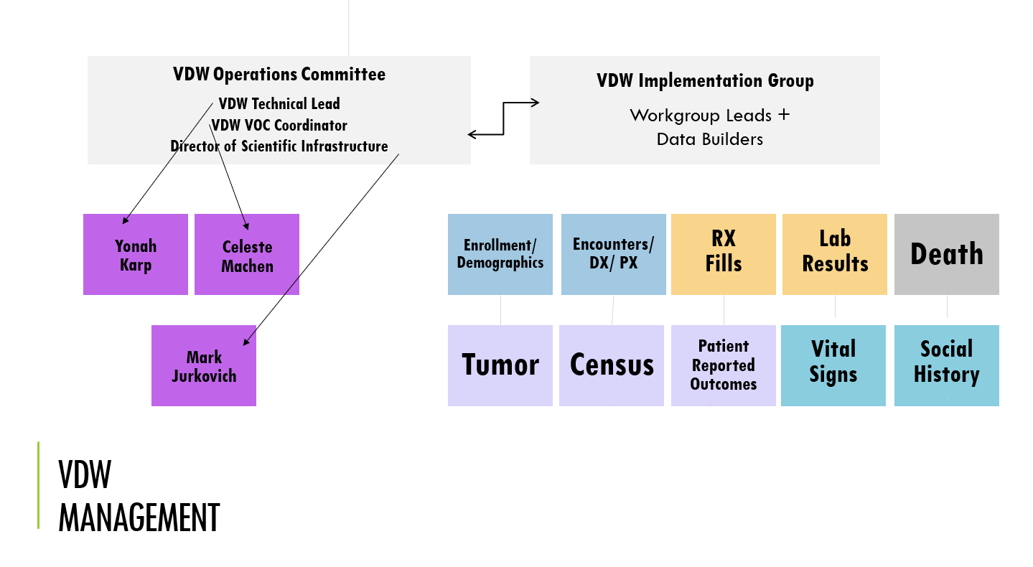
VDW Governance Schematic

Slide 36

Communications
Conference Calls
  VIG Conference Calls: Fourth Tuesdays @ 12:00-1:00 pm Pacific Time
  Workgroups: various times—see the list on SharePoint
E-Mail Lists
  One for VIG
  One per Workgroup
  Email the VOC chr_vdw_voc@kpchr.org to be added
Teams Channels
  Also, one per Workgroup
  Plus, other general channels
We need your expertise!
  Nearly all of this is volunteer effort
  Please consider joining us on workgroups
Workgroup Call Schedule

Slide 37
Thank You!
Roy, Heather, Pragati, Aung & Yonah

Slide 38
Questions?

Slide 39
Spec Change Management
Someone sees the need for a change to a VDW spec.
The idea gets discussed on the relevant workgroup's calls.
Someone writes a Change Proposal that
  Sets out the problem
  Sets out the proposed change (add/remove fields, split a table out into 2 tables, etc.)
  Describes how the change will address the problem.
The Proposal is posted to the MSTeams Channel, and the link e-mailed out to the VIG group, who are asked to forward to their local users & investigators.

