Slide 1
Orientation to the Health Care Systems Research Network and the Virtual Data Warehouse
Lois Lamerato, PHD
Henry Ford Health System
& HCSRN Governing Board
Amy Butani
HealthPartners Institute
& HCSRN VDW Operations Chair
HCSRN Conference
April 11, 2018
Minneapolis, MN

Slide 2
HCSRN Overview
The Health Care Systems Research Network (HCSRN), formerly known as the HMO Research Network, is a consortium of 18 health care systems that have embedded research units.
Members of the HCSRN conduct public domain research meant to advance population health, utilizing electronic health record data, very large and stable patient populations, and the expertise of more than 1900 scientists.
HCSRN member systems provide care to commercially insured individuals and those insured via Medicare, Medicaid, state specific gap programs and other financial arrangements.
Thus, HCSRN-based research can address clinical and health policy questions relevant to every market segment through which Americans receive health care

Slide 3
Synopsis
The course will describe the resources and capabilities of the HCSRN, including its structure, partnership opportunities, electronic health data and “virtual” data warehouse, research review/IRB processes, and several flagship research projects.
Attendees will come away with a broad understanding of how the HCSRN functions as a learning health system, in which health care informs research, and research informs and supports health care. In an increasingly data-driven world, the HCSRN demonstrates the pivotal importance of understanding and using electronic health care data to address public health challenges.
Examples will show how HCSRN contributes to public health surveillance, vaccine safety, health policy, and improving care for vulnerable populations. Members of the course faculty bring more than four decades of experience working in the HCSRN. They will use their applied expertise to raise the participants’ level of understanding of how health care system-based research is a vital component in advancing public health.

Slide 4
Objectives
Review the capabilities of the HCSRN and how it supports epidemiology and other research germane to improving public health
Describe how to craft potentially suitable research questions that leverage the HCSRN capabilities
Explain how the VDW utilizes different sources of health care data can be combined across multiple participating health systems and used in a research context

Slide 5
Main Topics
HCSRN: Who, What, Why & How
Collaboration: research networks, annual conference and scientific interest groups
Data Capabilities: Virtual Data Warehouse & Distributed Data Model

Slide 6
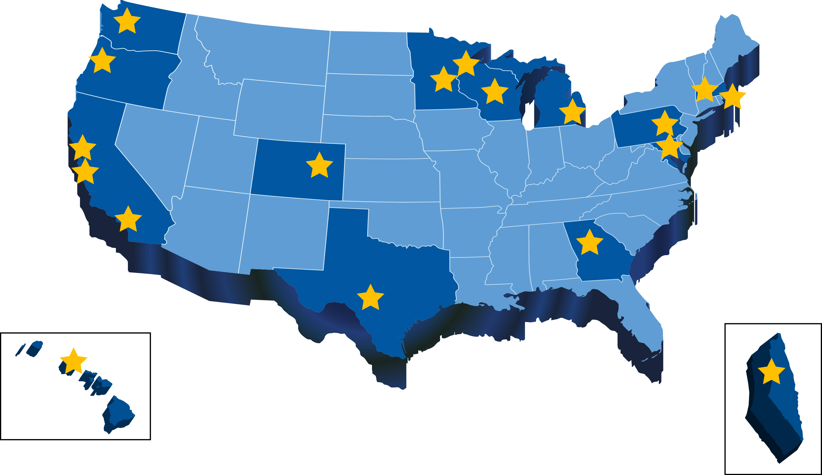
What & Who We Are

Slide 7
Mission, Vision & Values
Mission: To improve individual and population health through research that connects the resources and capabilities of learning health care systems
Vision: The HCRSN is the nation’s preeminent source of population-based research that measurably improves health and health care
Values:
Scientific excellence
Innovation and creativity
Actionable research findings
Collaboration and teamwork
Transparency
Efficiency

Slide 8
About the HCSRN
The Health Care Systems Research Network brings together research centers embedded within some of the best and most innovative US healthcare systems
Collectively, the HCSRN involves >1,900 scientists and research staff with methodological and content expertise from an array of disciplines and topic areas
After 20 years as HMORN, name changed in 2015 to reflect evolving membership
Disciplinary Expertise
Epidemiology
Health Services Research
Health Economics
Social Sciences
Public Health
Examples of Topical Expertise
Addiction
Aging
Cancer
Chronic Disease
Disparities/Health Equity
Infectious Disease
Mental Health
Women’s Health
16+ million patients & members

Slide 9
HEALTH CARE SYSTEMS RESEARCH NETWORK
HealthPartners Institute HealthPartners – Minneapolis, MN
Marshfield Clinic Research Foundation Marshfield Clinic
Marshfield, WI
Health Research Institute – Kaiser Permanente Washington Seattle, WA
Institute for Health Research
Kaiser Permanente Colorado
Denver, CO
Essentia Institute of Rural Health - Essentia Health
Duluth, MN
Meyers Primary Care Institute, UMass Medical School - Fallon Community Health Plan; Reliant Medical Group
Worcester, MA
Center for Health Services Research; Public Health Sciences - Henry Ford Health System
Detroit, MI
Center for Health Research - Kaiser Permanente NW Portland, OR
Harvard Pilgrim Health Care Institute, Dept. of Population Medicine Harvard Medical School
Boston, MA
Division of Research Kaiser Permanente Northern California Oakland, CA
Geisinger Research Geisinger Health System
Danville, PA
PAMF Research Institute - Palo Alto Medical Foundation Palo Alto, CA
Mid-Atlantic Permanente Research Institute - Kaiser Permanente Mid-Atlantic States Rockville, MD
Department of Research & Evaluation Kaiser Permanente Southern California Pasadena, CA
Center for Clinical and Outcomes Research - Kaiser Permanente Georgia
Atlanta, GA
Division of Research Baylor Scott & White Temple, TX
Institute for Health Services Research Maccabi
Health Care
Services
Tel Aviv Israel
Center for Health Research Hawai’i Kaiser Permanente Hawai’i
Honolulu, HI
States in which HCSRN Research Groups are based
Other States
Notes:
ALTERNATIVE SLIDE #2
EDITING INSTRUCTIONS
Click on a text box to edit (outline is dashed), nudge or delete (outline is solid line).
Click on a call out line and CTRL+arrow keys to nudge. Click end points to lengthen/shorten the line.
To remove a state use the Format Painter tool or click the state and Format / Shape Fill as R185, G205, B229 (light blue).
To add a state use the Format Painter tool or click the state and Format / Shape Fill as R0, G84, B166 (dark blue).
Simply copy/paste and then reposition labels and call out lines for new states or sites added.
Ungroup KPHI and MHS to remove just one of these sites from the map.
See Table of HCS Characteristics for cross-reference of which health systems cover patients in which state(s).
Note – it is unfortunately not possible to ‘unbind’ DE from NJ

Slide 10
Member Requirements & Expectations
Ability (and willingness) to create a site virtual data warehouse (VDW)
Comprehensive data for a defined patient population
Investigators and staff dedicated and accountable to a recognizable research center or department
Share the HCSRN’s value and commitment to the conduct of non-proprietary research for the good of the public
Active participation in HCSRN governance and operations - including VDW, contractual and IRB efficiencies
Payment of annual dues to support shared infrastructure

Slide 11
Commonalities and Variability
Similar | Different
Research centers affiliated with healthcare organizations Dedication to public domain, non-proprietary research Scientists value collaboration Access to comprehensive healthcare services data for a defined patient/member population | Degree of research center integration with health plan Degree of service integration within the health organizations Size and complexity of research enterprises Organizational and staffing models Proportion, size, and diversity of the defined populations

Slide 12
How do HCSRN sites work together?
The HCSRN is a virtual network: A group of independent organizations sharing resources to achieve a common set of goals. Members bond based on shared scientific interests, pursue collaborative research.
The HCSRN is… | The HCSRN is NOT….
An informal alliance (“coalition of the willing”) | A legal or corporate entity
Sustained by membership dues, and largely volunteer based | An externally funded research network
Committed to publishing findings in the public domain | The internal research analytics departments for health systems
Increasingly diverse in its health system membership | Just HMOs
Operated by a staff who are located in multiple health systems | A “bricks & mortar” physical entity

Slide 13
How does the HCSRN Function?
Formalized structures, processes, and resources provide substance and presence and make HCSRN more than the sum of its parts or research projects
Board & Executive Committee  direction, leadership, self-reflection
Membership Dues  support distributed, core HCSRN staff
Committees and Working Groups  streamline, formalize processes
Collaboration Toolkit  codify tools, knowledge and best practices
Virtual Data Warehouse  standard approach to ease data pooling
Website and Communications  establish identity, build transparency
Annual conference and Scientific Interest Groups (SIG)  network, foster a sense of community

Slide 14
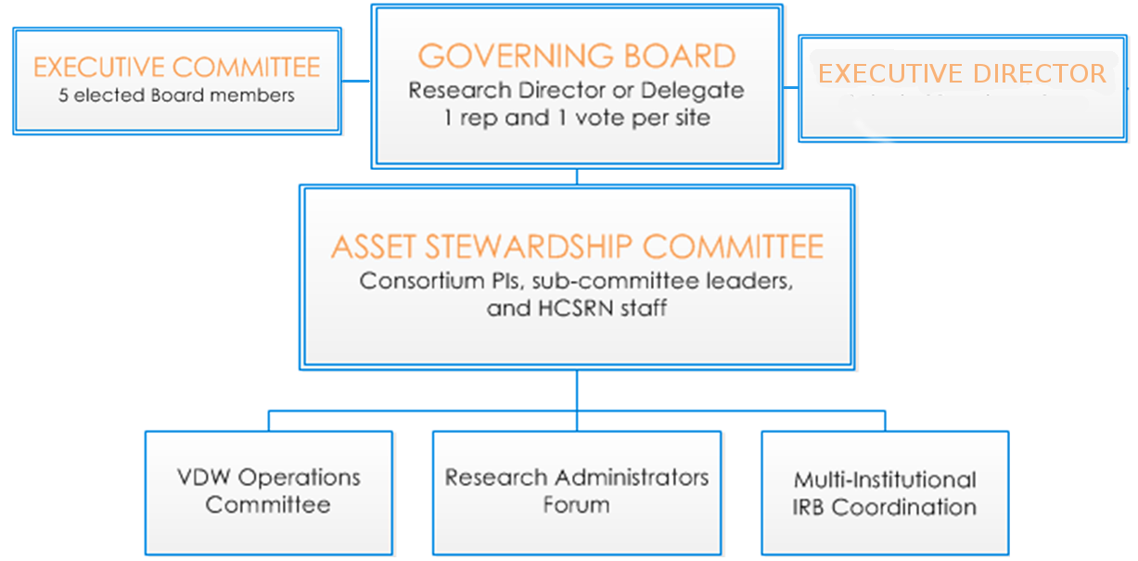
Leadership & Governance
Notes:
Executive Director (new as of 2016) provides overall leadership for strategy, operations, finance, communication
Formal bylaws document governance processes
1 representative/site serves on volunteer Governing Board
Consensus-driven governance model (1 vote/member)
Elected Chair and Vice Chair lead the Governing Board and Executive Committee (2-year terms)

Slide 15
Key Committees Support Goal of Efficient, High-Functioning Research
Committee | Description
Governing Board | Set policy, budget and strategic direction
Executive Committee | Increase Board efficiency and agility. Manage Board policies and initiatives
Asset Stewardship | Inward facing, cross-project coordination. Create and maintain shared infrastructure
IRB Coordination | Develop and implement Network-wide ceding processes
Virtual Data Warehouse (VDW) Operations | Coordinate, support and oversee VDW development and management across sites Hiring: Director of Infrastructure
Research Administrators | Share best practices. Develop and implement HCSRN-wide administrative efficiencies
Scientific Interest Groups | SIGs are assemblies of scientists with common research interests, which form and evolve regularly as new scientific trends arise
Data Advisory Subcommittee | DAS is a standing subcommittee of the Governing Board and was formed to provide strategic guidance pertaining to the spectrum of issues related to HCSRN data development

Slide 16
Collaboration

Slide 17
Range of tools to facilitate new and existing research activities
Common data model (VDW)
Reciprocal IRB review and related Authorization Agreement
Pre-negotiated subcontract templates
Data use/data sharing agreement templates
Web portal with private sites for projects and committees
Contact directories
Stock text, tables, and figures for grant proposals
Toolkits and guides from start up to close out
Public websites
Listservs, biweekly newsletter
Communication boilerplate for grant proposals

Slide 18
Value of Network Membership
Leverage expertise, variation, resources across sites
Share best practices, methodologies, processes to save time, build efficiency, gain competitive edge
Share a culture of collaboration and identity for the collective enterprise
Share a culture of collaboration and identity for the collective enterprise
Maintain shared infrastructure that is not tied to grant funding or to specific disease topics

Slide 19
HCSRN Connection Points
Current HCSRN
Collaborative Projects
Mental Health Research Network
Cardiovascular Research Network
AGING Initiative
Addiction Treatment Network
Sentinel Initiative (Drug Safety)
PCORnet
Vaccine Safety Datalink
Numerous entry points for connecting with other researchers in the HCSRN community:
HCSRN website, www.hcsrn.org
News for the Network Listserv (open to all)
Contact lists (researchers, key site staff)
Existing projects
Scientific interest groups
Annual Scientific Conference
www.hcsrnmeeting.org
Scientific Interest Groups
Addiction
Aging
Genomics
Patient Engagement
Obesity
Qualitative Research
Health Equity/SDOH
Natural Language Processing
Training & Mentoring

Slide 20
Connecting with Collaborators
A site PI is identified for each site participating in a multicenter project. In some studies, depending on budget, study needs, and data availability, a site may participate in scientific collaboration or other aspects of the study without being a data collection site
Some ways to connect with HCSRN researchers are:
Scientists in your local area who may be connected to HCSRN projects
Review our Scientific Interest Groups to find topics of interest
Search tool or Researcher Directory on HCSRN website
Or ask us! (sarahgreene@hcsrn.org)

Slide 21
Website: www.hcsrn.org
Fully public website, with link to member portal
About our organization (vision, aims, communication tools)
Member organizations (member criteria, Board roster, site descriptions, membership inquiry process)
Resources (directories, collaboration toolkit, outreach and orientation materials, scientific conference calendar, funding opportunities)
News (current and e-newsletter archive)
Link to annual conference and past conference materials
Research Projects (largest HCSRN-based consortia projects)

Slide 22
HCSRN Data Resources & Capabilities

Slide 23
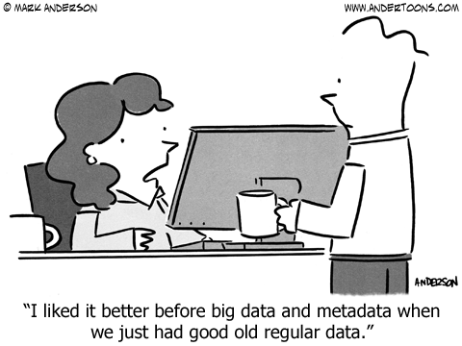

Slide 24
What is the HCSRN Virtual Data Warehouse (VDW)?
The VDW is a federated common data model designed to facilitate research use of health system data
16.8 million CURRENT patients & members plus HISTORICAL DATA
Notes:
Maccabi has 2,000,000 patient/members, but does not build a VDW.

Slide 25
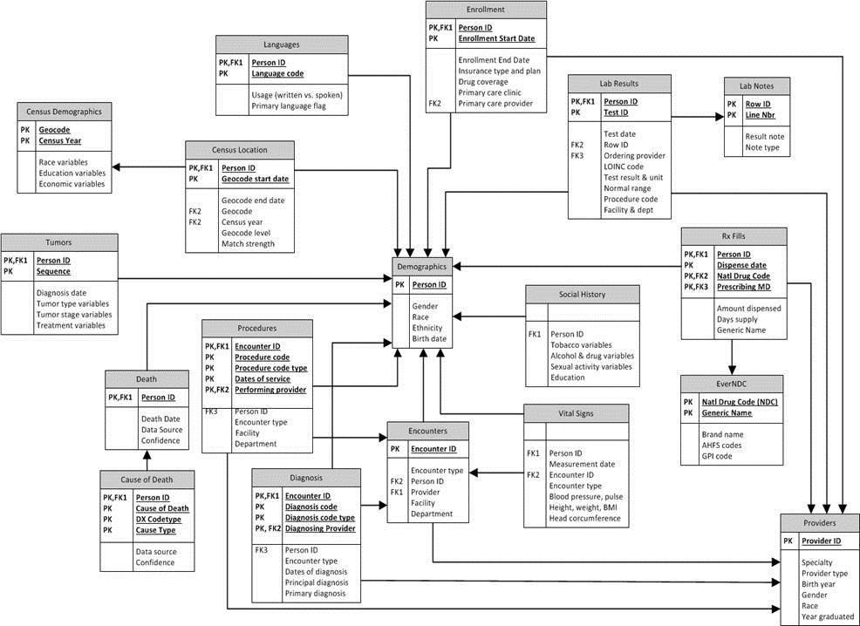
What is a Federated Common Data Model?
A CDM is way of organizing data into a standard structure allowing heterogeneous business environments to interoperate.
Federated Database System is a de-centralized data warehouse , aka “distributed” or “virtual”, that can be easily merged across sites.

Slide 26
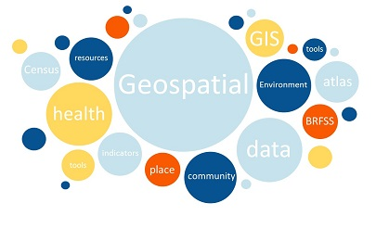
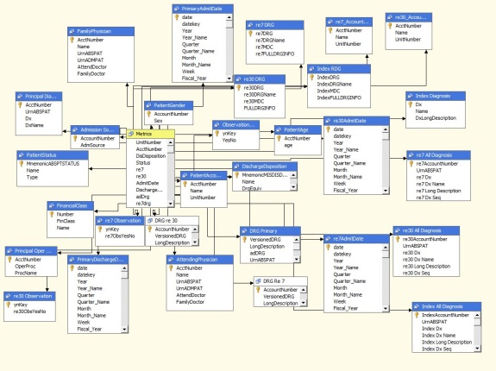
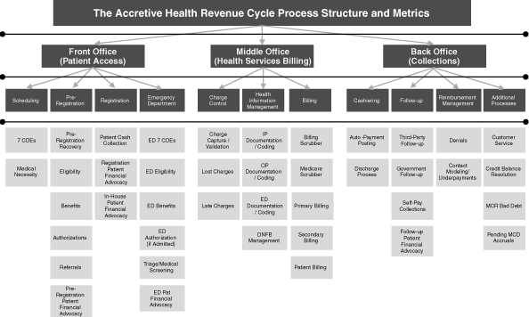
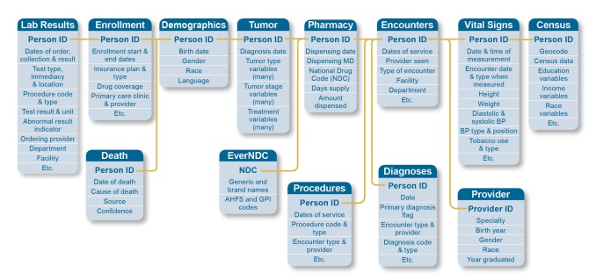
What kind of data?

Slide 27
Why Have a VDW?
Pre-VDW (circa 2002): Collaborative studies had each site doing its own custom programming.
At project end—toss the data (!)
Expensive
Redundant
Ad hoc
Poorer quality
Lessons lost
Complicated Sources…..

Slide 28
Example of Sources
Claims
System | Dates | N
HCFA (professional) | 1990 – 2012 | 66M
UB (facility) | 1990 – 2012 | 5.2M
EMR
System | Dates | N
Patients | 2004 – Now | 3.3M
Encounters | 2004 – Now | 144M
Encounter Diagnoses | 2004 – Now | 93M
Ordered Procedures | 2004 – Now | 75M
Social History | 2004 – Now | 3.7M
Patient Races | 2004 – Now | 402K
And many others!
Lab Systems
System | Dates | N
Legacy MVS | 1988 – 1998 | 88M
Statewide Lab Results (Sybase) | 1999 – Now | 134M
Inpatient/Institutional
System | Dates | N
Unified Hospital | 1985 – now | 1.2M
CareTracker | 1998 – 2012 | 1.3M
Rx Fills
System | Dates | N
CoopRx | 1977 – now | 124M
Whatcom RX | 1993 – 2000 | 2M
Options RX | 1995 – 2000 | 766K
Alliant | 1995 – 2000 | 1.2M
MedImpact | 2000 – now | 29M
RxStar | 2001 – 2002 | 931K
Internal Visit Systems
System | Dates | N
Registration | 1993 - 1995 | 6M
ARPA | 1995 - 2002 | 16M
LastWord | 2003 - 2009 | 14M
Central OIC | 2005 – 2009 | 29K
Lab | 1988 – now | 207M
Radiology | 1993 – now | 8.5M
Cost Management Data | 2004 – now | 187M
Miscellaneous
System | Dates | N
Breast Cancer Screening | 1996 – now | 844K
CHSID | n/a | 100M
UMLS | n/a | 70K
Membership & Billing
System | Dates | N
Baseline | 1988 – 2012 | 20M
Consumer Demographics | 1988 - 2012 | 3.4M
Snapshot Enrollments | 1988 – 2012 | 21M
Benefits | 2001 – 2011 | 7M
Retro | 2002 – 2012 | 75M
Cost Management Data
System | Dates | N
Practice Management Hospital Charges | 2009 – now | 1M
Practice Management Professional Charges | 2009 – now | 10M
Sapient | 2009 – now | 609K
CHS (Home Health) | 2004 – now | 922K
CONSNRSE (Consulting Nurse) | 2004 – now | 1.8M
LAB | 2004 – now | 22M
Premier Claims (institutional) | 2004 – now | 23M
Premier Claims (professional) | 2004 – now | 43M
Lastword Charges | 2004 – 2009 | 27M
CoopRx | 2004 – now | 40M
Eastern WA Medical | 2001 – 2003 | 359K
MedImpact Rx | 2004 – now | 18M
AMR | 2002 - 2004 | 63K
External Data
System | Dates | N
SEER Extract | 1996 – now | 844K
WA DOH Death Certificates | 1972 – 2010 | 179K
USCB Geo-Demographics | 2000 | 2.4M

Slide 29
Can’t we just use what’s in the EHRs?
Nope!
Clinicians vary in how they record health information
EHRs/EMRs vary in how they store and organize data
Even the same EHR vendor’s product will vary
Compiling data across sites requires cleaning inconsistencies
Neither EHR nor insurance claims yield “research ready” data – some level of cleaning needed
So optimal to have a mechanism to store and share the insights learned from data cleaning & use (“curation”)

Slide 30
Why a distributed data model?
Pre-VDW (circa 2002): Study data sent to one location
Legal Risk – one site holding all data
Difficult logistics of secure data transfer
Data quality assurance = complex, costly
Data availability varied by time and source

Slide 31
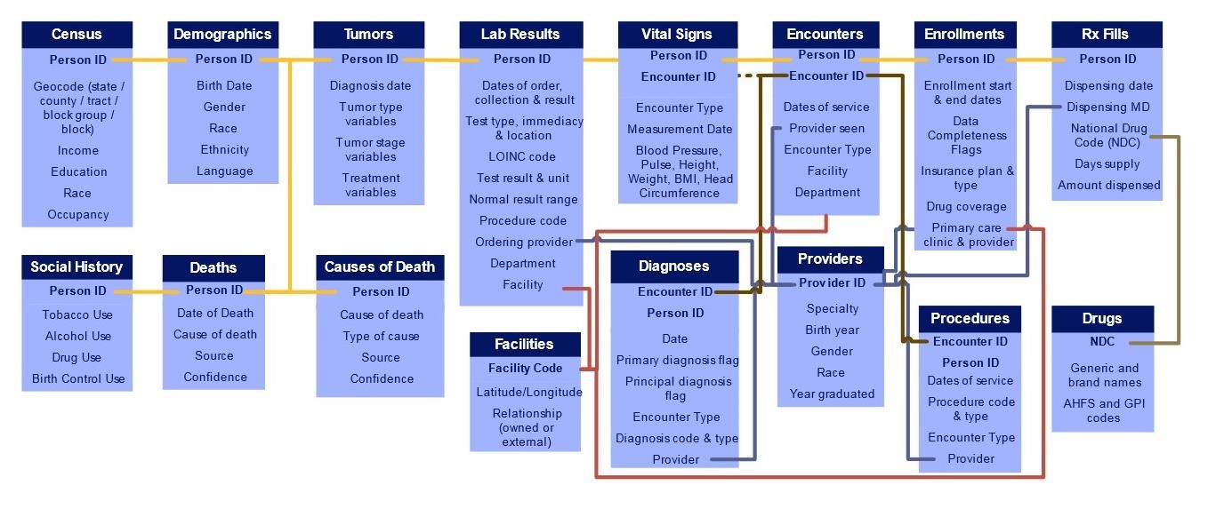
VDW makes data usable across sites

Slide 32
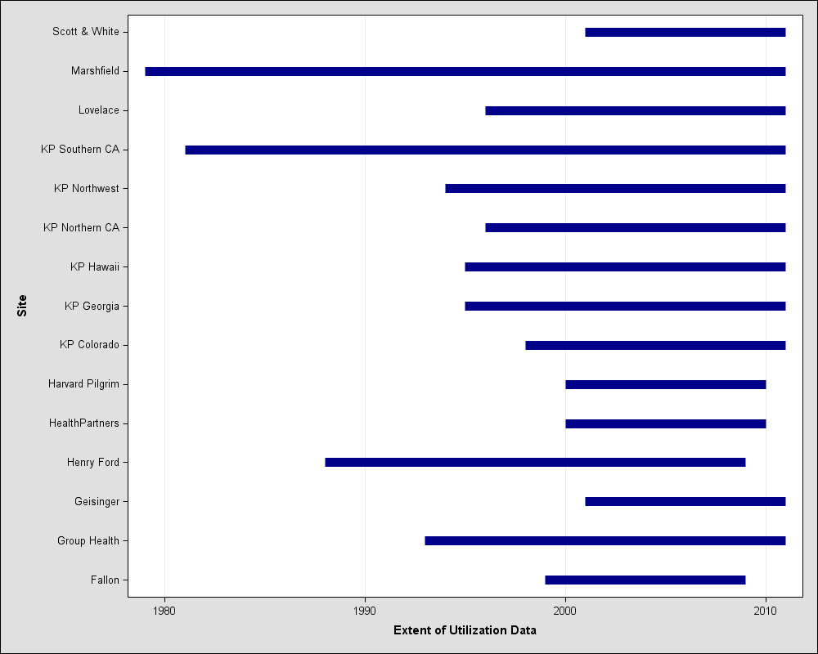
Site Data Managers Serve as Local Content Experts
Data varies by site, by content area, and by variable

Slide 33
VDW Guiding Principles
Facilitate public domain health research
Facilitate compliance with human subjects protection and privacy regulations
Data model is public and nonproprietary
Flexible and extensible towards participants, research interests, and data sources
Data model is agnostic to source data systems
Work groups comprised of both scientific and technical leads to ensure appropriate blend of expertise

Slide 34
Data Flow in and out of the VDW
Source: Ross T et al, eGEMS 2014

Slide 35
How does the VDW work for Multisite Queries?

Slide 36
Opportunities Enabled by the VDW (1)
Feasibility – How many patients with diabetes received a statin between 2007-2017?
Simple programs
Counters
Consultation
Refined Assessment of Data Availability & Quality
Metadata surveys
Evaluative programs
Identify areas for data development (e.g., chemotherapy, genomics)

Slide 37
Opportunities Enabled by the VDW (2)
Improvement – Data get better with use
Work through data quality issues
Develop non-VDW data infrastructure
Study-specific application
Allows new discovery of data idiosyncrasies
Fosters discussion of “what’s next” for VDW data development

Slide 38
Bringing Science, Data & Technology Together
Goal is to promote dialogue among scientists and our data developers to best prepare us for the next wave of HCSRN research activities
Data science is an increasingly important skill and will be an integral part of solving many persisting challenges in health and healthcare improvement

Slide 39
Resources for One’s Inner Data Geek
HCSRN.ORG Toolkit
Programming Guide
Standard Macros and Standard Variables

Slide 40
Summary – HCSRN VDW
The Virtual Data Warehouse (VDW) is the HCSRN’s method for standardizing and pooling electronic health data for multicenter research
The HCSRN VDW is a common approach, not a central database
Member sites agree on data to make available for research, and on definitions and standard formats to apply
Raw administrative, clinical and claims data are transformed to the agreed upon set of agreed upon data standards at every HCSRN site
Each institution’s VDW data remain at their site until a study-specific need arises
The required study data are extracted after contractual, IRB, and HIPAA requirements are met

Slide 41
Thank you VDW Work Group Leads!
Work Group | Scientific Lead | Technical Lead
Lab | Dr. Stacey Honda, KPHI | Gwyn Saylor, KPNW
Census | Dr. Rob Penfold, GHRI | Chris Mack, GHRI & David Tabano, KPCO
Enrollment and Demographic | Dr. Matthew "Mateo" Banegas, KPNW | Roy Pardee, KPWA
Pharmacy | Dr. Pamala Pawloski, HPI | Catherine Cleveland, KPNW
Tumor | Dr. Lois Lamerato, HFHS | Rebecca Ziebell, KPWA
Utilization | Seeking New Lead | Heather Tavel, KPCO & Dan Ng, KPNCal
Vital Signs and Social History | Dr. Christine Neslund-Dudas, HFHS | Bruce Folck, KPNCal – Seeking New Lead

Slide 42
Thank you VDW Site Data Managers!
Baylor Scott and White Health | I-Chia Liao
Essentia Health | Paul Hitz
Fallon Community Health Plan | Hassan Fouayzi
Geisinger | Joe Leader
Harvard Pilgrim Health Care | Yury Vilk
HealthPartners Institute | Amy Butani
Henry Ford Health Systems | Rick Krajenta
Kaiser Permanente Colorado | Mark Gray
Kaiser Permanente Georgia | Lee Cromwell
Kaiser Permanente Hawai'i | Valentyna Pishchalenko
Kaiser Permanente Mid-Atlantic | Eric Watson
Kaiser Permanente Northern California | Marvin Yan
Kaiser Permanente Northwest | Catherine Cleveland
Kaiser Permanente Southern California | Donald McCarthy
Kaiser Permanente Washington | Roy Pardee
Marshfield Clinic | Brian Hoch
Palo Alto Medical Foundation | Pragati Kenkare & Kevin Hays

Slide 43
Summary & Concluding Thoughts

Slide 44
Summary of Capabilities
The HCSRN has unique advantages
Longitudinality, diversity, embeddedness, depth of data
Research pedigree: long and successful track record
We are very interested in collaborating in the full spectrum of research
Eager to engage with public health

Slide 45
Thought experiments
If you had access to data on 3% of the country’s birth cohort, what questions would you pursue?
If you could get health care providers to routinely collect or process data for research, what would be most useful?
Linked data from mothers and infants?
Social Risk Factors?
Immunizations & cancer screening data?

Slide 46
Concluding Thoughts
HCSRN has built a substantial infrastructure over 25 years, with the intent of bolstering scientific agility & overall visibility
Research environment is increasingly reliant on collaboration, and to the extent we can find ways to facilitate collaboration and harmonize research administration between network members and external collaborators, we can create a competitive advantage when seeking funding
The HCSRN has been prescient in many undertakings, including creation of a common data model and IRB streamlining, we are actively looking ahead to the next frontiers in research and health care, and how we can leverage our assets to stay ahead of the curve

Slide 47
Ideal: Learning Health Care System

Slide 48
Thank you!
Have questions or feedback about this presentation?
Contact us!
admin@hcsrn.org
www.hcsrn.org
@hcsrn

